Slide 1

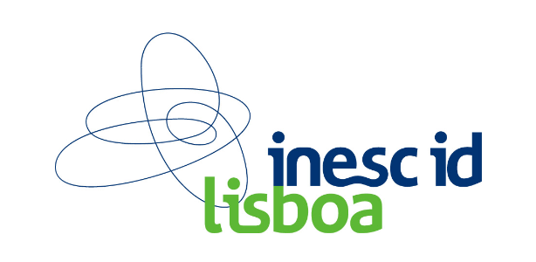

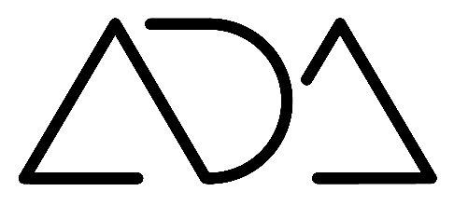
Conflicting Goals in Architecture A Study on Multi-Objective Optimization
April 2019
Catarina Belém
António Menezes Leitão
Presented by:
Inês Caetano & Renata Castelo Branco

Slide 2
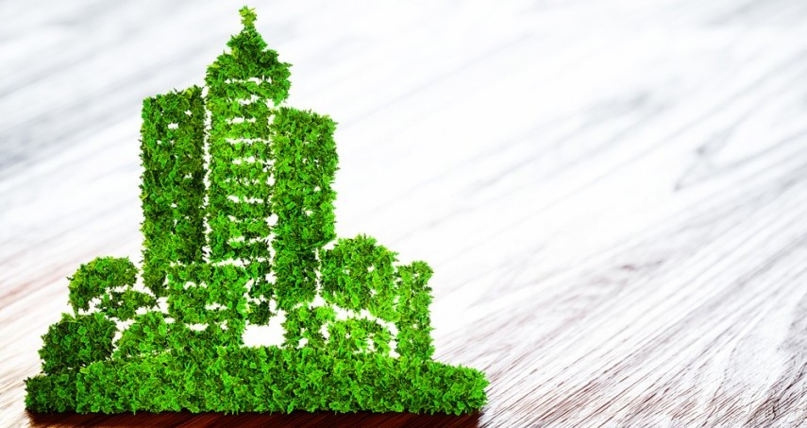
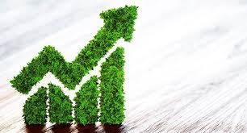
Motivation
Sustainability
Economic
Notes:
Environmental and economic concerns have led to adoption of a design approach that seeks for more efficient design solutions regarding different requirements: thermal, energy, lighting, etc.
*click*

Slide 3
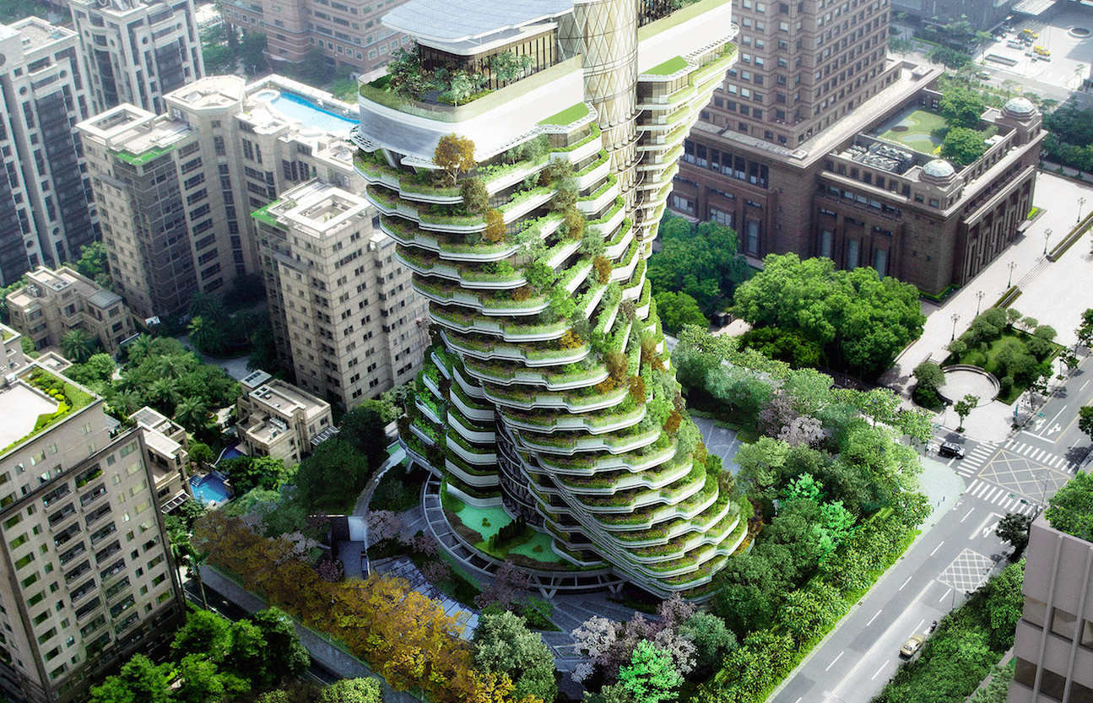
Optimization
http://vincent.callebaut.org/object/110130_taipei/taipei/projects
Agora Garden Tower, Taipei Taiwan, by Vicent Callebaut Architectures
Notes:
This approach is also known as Performance based Design and benefits from:
AD approaches, which gives design flexibility and the ability to explore a larger design space,
simulation tools to analyze the different solutions.
Still, to find the best option it is therefore required the use of optimization techniques.
* Image *
As an example, the Agora Garden Tower which was designed to reduce both the energy consumption and the greenhouse carbon emissions.

Slide 4
Optimization
http://vincent.callebaut.org/object/110130_taipei/taipei/projects
Agora Garden Tower, Taipei Taiwan, by Vicent Callebaut Architectures
Notes:
This combination of AD, simulation and optimization has many advantages *click*
+ efficient design variations *click*
+ informed design process.

Slide 5

Optimization
http://vincent.callebaut.org/object/110130_taipei/taipei/projects
Agora Garden Tower, Taipei Taiwan, by Vicent Callebaut Architectures
Notes:
This combination of AD, simulation and optimization has many advantages *click*
+ efficient design variations *click*
+ informed design process.

Slide 6

Optimization
http://vincent.callebaut.org/object/110130_taipei/taipei/projects
Agora Garden Tower, Taipei Taiwan, by Vicent Callebaut Architectures
Notes:
This combination of AD, simulation and optimization has many advantages
+ efficient design variations *click*
+ informed design process.
Optimization is rarely used:

Slide 7

Optimization
http://vincent.callebaut.org/object/110130_taipei/taipei/projects
Agora Garden Tower, Taipei Taiwan, by Vicent Callebaut Architectures
Notes:
difficulties in defining the optimization problem *click*

Slide 8

Optimization
http://vincent.callebaut.org/object/110130_taipei/taipei/projects
Agora Garden Tower, Taipei Taiwan, by Vicent Callebaut Architectures
Notes:
need for high expertise

Slide 9
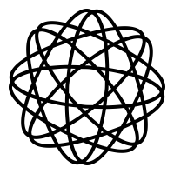
Optimization
http://vincent.callebaut.org/object/110130_taipei/taipei/projects
Agora Garden Tower, Taipei Taiwan, by Vicent Callebaut Architectures
Notes:
complexity of the tools

Slide 10

Optimization
http://vincent.callebaut.org/object/110130_taipei/taipei/projects
Agora Garden Tower, Taipei Taiwan, by Vicent Callebaut Architectures
Notes:
long computation time

Slide 11


Optimization
http://vincent.callebaut.org/object/110130_taipei/taipei/projects
Agora Garden Tower, Taipei Taiwan, by Vicent Callebaut Architectures
Notes:
Idea that it restricts the creative process of the architect
Here we focus on optimization processes, mainly the Multi-objective optimization ones, those that reflect the fact that building design involves multiple conflicting goals.

Slide 12




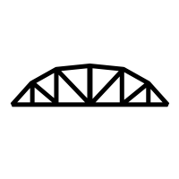
Optimization
http://vincent.callebaut.org/object/110130_taipei/taipei/projects
Agora Garden Tower, Taipei Taiwan, by Vicent Callebaut Architectures
Notes:
Which includes: structural, thermal, economic, etc.
Since there are multiple requirements, the use of single objective optimization techniques is not enough, mainly because the best option for one of the requirements is rarely the best one for the others.

Slide 13

Optimization
http://vincent.callebaut.org/object/110130_taipei/taipei/projects
Multi-Objective Optimization
Agora Garden Tower, Taipei Taiwan, by Vicent Callebaut Architectures
Notes:
We therefore need to apply a multi-objective optimization methods.

Slide 14
Multi-Objective Optimization
Design
of
Experiments
A priori
Preference Articulation
Pareto Optimization
Notes:
There are multiple approaches to MOO.
The first one is

Slide 15
Multi-Objective Optimization
Design
of
Experiments
A priori
Preference Articulation
Pareto Optimization
Notes:
Based on the evaluation of different design variations resulting from different combinations of parameters

Slide 16
Multi-Objective Optimization
Design
of
Experiments
A priori
Preference Articulation
Pareto Optimization
multiple designs
sampling methods
Notes:
By using sampling methods (e.g. Monte carlo sampling ad Latin hypercube).

Slide 17
Multi-Objective Optimization
Design
of
Experiments
Simple
Flexible
Availability
More informed process
Notes:
Advantages:
simple and flexible approach
available in multiple tools
more informed process: set of design variations and associated performance
Disadvantages:
does not guarantee that good solutions will be found
does not take advantage of the information obtained in previous evaluations

Slide 18
Multi-Objective Optimization
Design
of
Experiments
Simple
Flexible
Availability
More informed process
No quality guarantee
Not intelligent process
Notes:
Advantages:
simple and flexible approach
available in multiple tools
more informed process: set of design variations and associated performance
Disadvantages:
does not guarantee that good solutions will be found
does not take advantage of the information obtained in previous evaluations

Slide 19

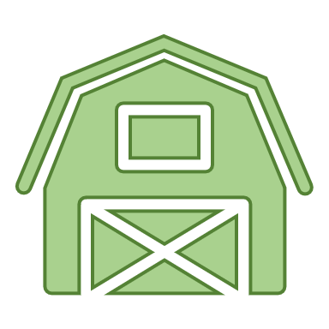







Design of Experiments
Quality of solutions
Simplicity and flexibility
Sensitivity analysis
Full information
…
…
= cost = daylight conditions = thermal conditions
Notes:
Consider the example of an experiment-based approach, regarding optimization of a residential design. You want to optimize it with regards to 3 different aspects, so as you already know, you will use a Multi Objective Optimization approach.
1. We generate multiple variations for the same design
2. Obtain each variation’s performance measures
3. Make a utility function to classify which solutions are better
Provides no guarantee about quality of solutions (generates designs blindlessly)
Simple, flexible and easy to use approach (generate designs, evaluate them, chose the best)
Basis to sensitivity analysis methodologies – allows to extract information about different designs
Gives the user full disclosure about the optimization process and its evolution (generated solutions)

Slide 20
Multi-Objective Optimization
Design
of
Experiments
A priori Preference Articulation
Pareto Optimization
Notes:
The second approach considers the integration of multiple objective in single fitness function.

Slide 21
Multi-Objective Optimization
Design
of
Experiments
A priori Preference Articulation
Pareto Optimization
utility function
weighted objectives
Notes:
Which is known as utility function. it combines the set of objectives according to the user’s preference, reducing a Multi-Objective Optimization problem to a single one.
Advantages:

Slide 22
Multi-Objective Optimization
Easy use
Availability
Ready to use tools
Time required
Intelligent process
A priori Preference Articulation
Notes:
Advantages:
Easy use
availability
diversity of ready to use tools (Opossum, Galapagos)
time required
enables a more intelligent design process (previous evaluations knowledge is taken into consideration)
Disadvantages:

Slide 23
Multi-Objective Optimization
Easy use
Availability
Ready to use tools
Time required
Intelligent process
A priori Preference Articulation
Loss of control
Single option
Little information
Notes:
Disadvantages:
Architect’s loss of control
returns a single option
does not provide enough information to support future decisions

Slide 24
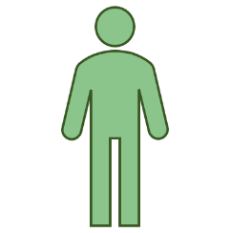

A Priori Preference Articulation
More Intelligent
Single preference
Single solution
Design control
John
Ray & Ray Junior
= daylight conditions = thermal conditions
Notes:
Let us a consider a concrete example. This example is concerned to the decision of buying a house.
Every house is characterized differently, depending on the way it was designed, and the location it was built at (e.g., some houses are more comfortable than others, expensive/cheap, better/worse thermal conditions, better/worse daylight conditions)
Each person values each of these aspects differently, for instance John values cost, thermal conditions and daylight conditions the same and therefore, when he talks to the real agency, they will come back with a house like this one, which is optimized to his preferences! On the other hand, Ray as a son and as so, he values daylight conditions and the thermal conditions more, but he prefers that the house gets more daylight, even if he has to buy HVACs to reduce the temperature. The real state agency then comes back with that fulfils his preferences.
The search for optimal solution is guided towards better solutions (which did not happen in the previous approach), more intelligent
The search aims to satisfy a single preference instead of several (e.g., considering the cost dimension to the depicted example)
Most algorithms in this approach yield single solutions, e.g., Goat, providing no information about other design options
Might lose control over the design optimization process, when using autonomous algorithms / plug-ins.

Slide 25
Multi-Objective Optimization
Design
of
Experiments
A priori
Preference Articulation
Pareto Optimization
Notes:
Third approach aims at finding the existing trade-offs among the different objectives, returning a set of options from which it is impossible to improve one objective without affecting the others → the pareto front.

Slide 26
Multi-Objective Optimization
Design
of
Experiments
A priori
Preference Articulation
Pareto Optimization
Find Pareto-Front
Notes:
This allows the user to analyze this set of options and make informed decisions, by comparing the different options according to the different performance aspects.

Slide 27
Multi-Objective Optimization
Intelligent & Informed
Multiple solutions
Design control
Visualization
Performance
Pareto Optimization
Find Pareto-Front
Notes:
Regarding this approach advantages, it constitutes an intelligent and informed approach.
Returns multiple solutions
Gives design control
Allows the user to visualize multiple scenarios and know about its corresponding performance.

Slide 28
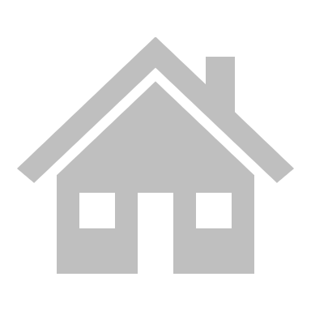
Pareto-Based Optimization
Notes:
As an example, imagine buying a house.

Slide 29

Pareto-Based Optimization
Notes:
We want to see all the houses that exist and

Slide 30


Pareto-Based Optimization
Notes:
know about their daylight and thermal conditions.

Slide 31



Pareto-Based Optimization
Notes:
But we want to buy a house that maximizes both conditions.

Slide 32

Pareto-Based Optimization
Notes:
Since to have a house with the optimum thermal condition

Slide 33



Pareto-Based Optimization
Notes:
we wont probably have the optimum daylight condition,

Slide 34


Pareto-Based Optimization
Notes:
we have to make a balance between both.

Slide 35

Pareto-Based Optimization
Notes:
This is a case where the pareto optimal approach is useful, as it provides the different compromises *click*

Slide 36

Pareto-Based Optimization
Notes:
Allowing us to see the options that best do this balance

Slide 37
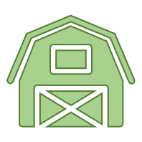
Pareto-Based Optimization
Notes:
Allowing us to see the options that best do this balance

Slide 38

Pareto-Based Optimization
Notes:
Allowing us to see the options that best do this balance

Slide 39

Pareto-Based Optimization
Notes:
Allowing us to see the options that best do this balance

Slide 40
Multi-Objective Optimization
Intelligent & Informed
Multiple solutions
Design control
Visualization
Performance
↑ N° evaluations
> 3 objectives visualization
Varying result quality
Pareto Optimization
Find Pareto-Front
Notes:
Not widely used because there are still some limitations:
It requires a higher number of function evaluations
the representation of the solution’s space becames a problem when dealing with more than 3 objectives
the fact that theway the optimization problem is modelled has a direct impact on the solutions’ quality.
this paper aims to address this by implementing and evaluating different pareto-based algorithms in a case study.

Slide 41
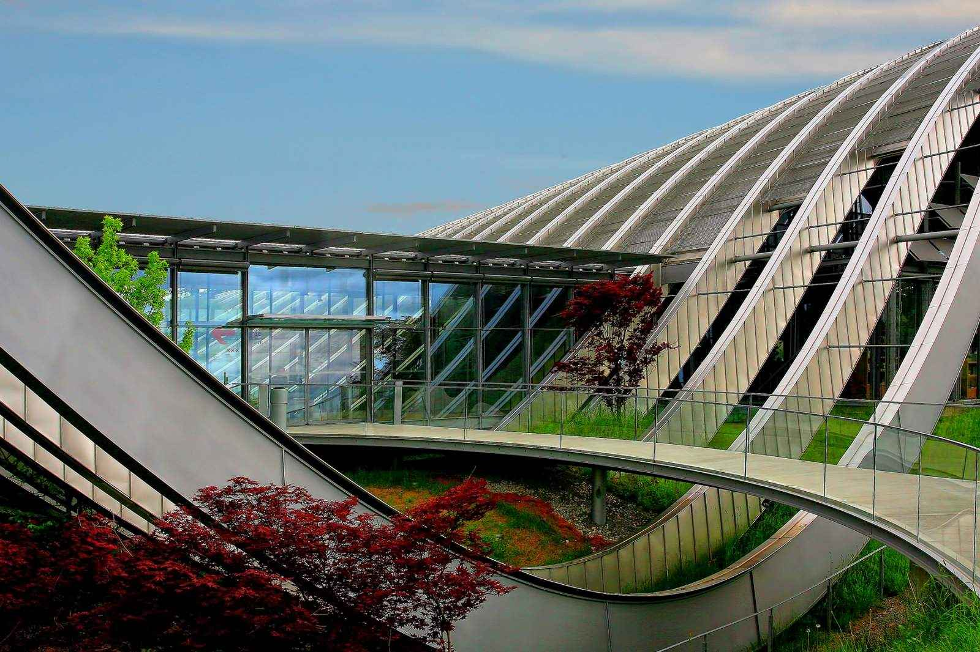
Case Study
Notes:
We have studied the performance of Pareto-based algorithms in a bi-objective case study

Slide 42
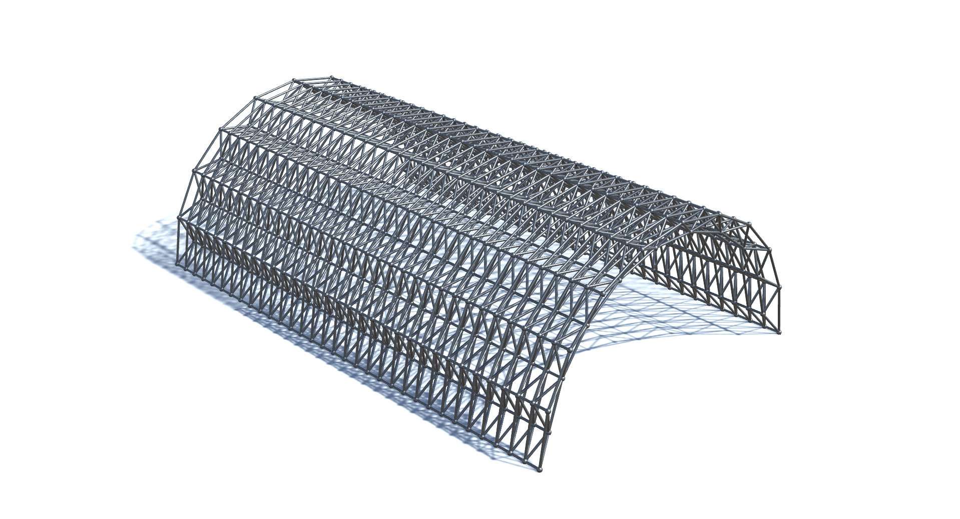
Case Study
Notes:
The project consisted in a arc-shaped space-frame

Slide 43

Case Study
Design Parameters
Notes:
to which we added three attractors that
*influence the shape of the frame around its vicinities
causing perturberations in the trusse’s shape - Like so.
Given the position of the atractors, the structural properties of the space-frame change.

Slide 44
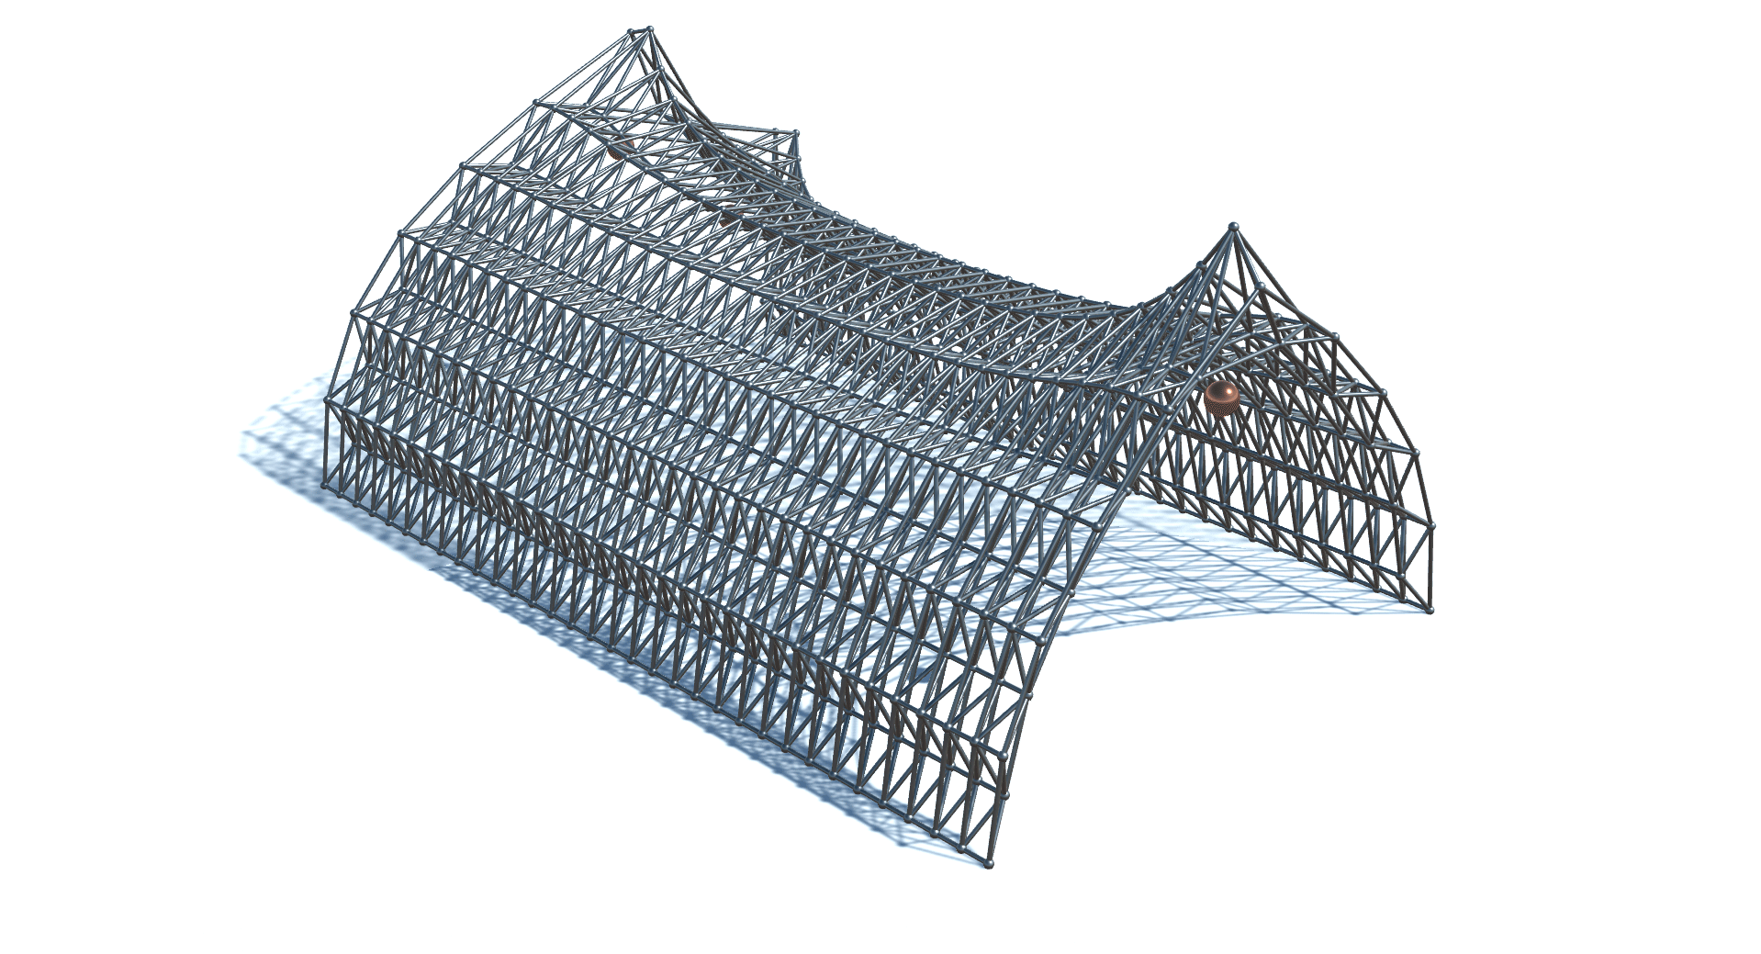
Case Study
Design Parameters
Notes:
to which we added three attractors that
*influence the shape of the space frame around its vicinities
causing perturberations in the trusse’s shape - Like so.
Given the position of the atractors, the structural properties of the space-frame change.

Slide 45
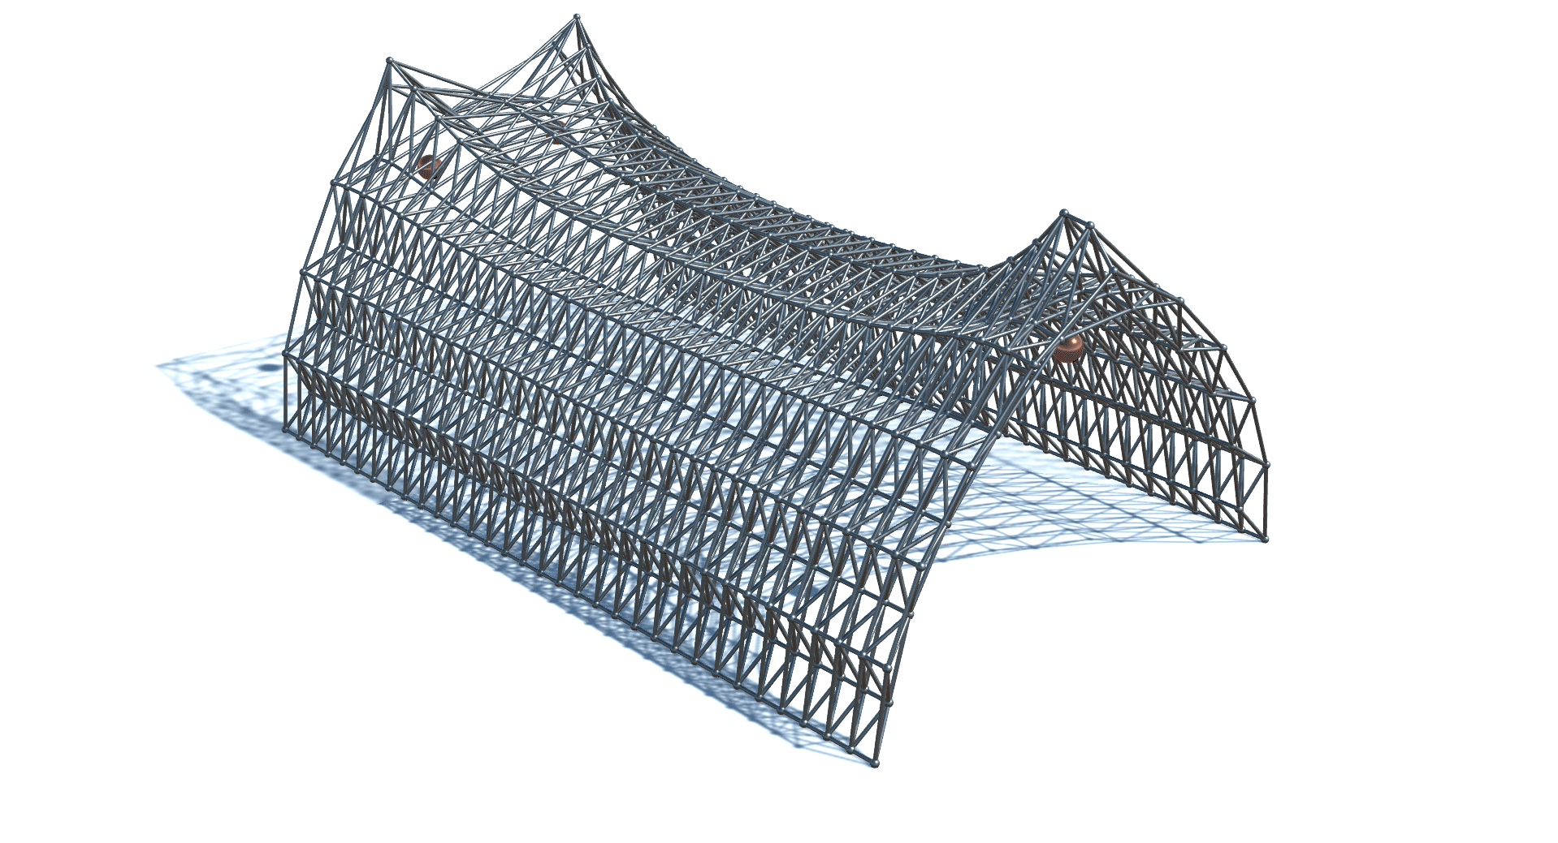
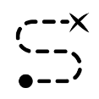
Case Study
Design Goals
Maximum Displacement
Distance between attractors
Notes:
And that is what we want to optimize – the structural behaviour = maximum displacement
However, we also added another criteria: since the algorithms naturally spread the attractors the maximum they could to the corners to optimize structural behavior, and that gave us no interesting results to compare.
2nd criteria: Euclidean distance between attractors – we wanted to minimize = force algorithms to bring them closer

Slide 46
Algorithms
Notes:
We have selected two different classes of algorithms to explore their adaptability to this problem:
*evolutionary algorithms and particle swarm algorithms.

Slide 47
Algorithms
Evolutionary Algorithms
Particle Swarm
Notes:
We have selected two different classes of algorithms to explore their adaptability to this problem:
*evolutionary algorithms and particle swarm algorithms.

Slide 48
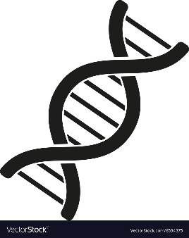

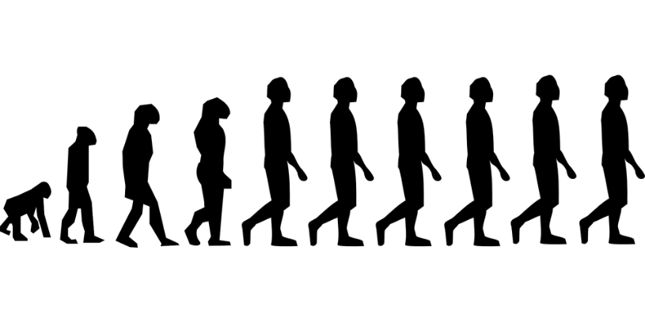
Algorithms
Evolutionary Algorithms
Particle Swarm
Notes:
Evolutionary algorithms draw inspiration from Darwin’s natural selection principles, genetic and evolution concepts.

Slide 49
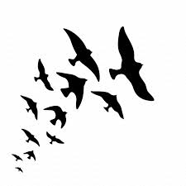
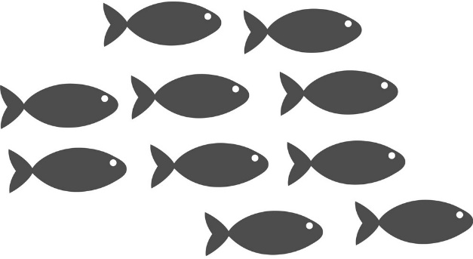
Algorithms
Evolutionary Algorithms
Particle Swarm
Notes:
Particle swarm draw inspiration from collective behavior, like the flocking birds or schooling fish.

Slide 50
Algorithms
Evolutionary Algorithms
Particle Swarm
Notes:
In terms of algorithms, we used a total of 8 for evaluation:

Slide 51
Algorithms
Evolutionary Algorithms
Particle Swarm
ε-MOEA
MOEA/D
NSGA-II
PAES
PESA2
SPEA2
Notes:
6 evolutionary

Slide 52
Algorithms
Evolutionary Algorithms
Particle Swarm
ε-MOEA
MOEA/D
NSGA-II
PAES
PESA2
SPEA2
SMPSO
OMOPSO
Notes:
and 2 particle swarm

Slide 53

Evaluation
Notes:
Regarding the evaluation methodology itself, *we tested these 8 algorithms.

Slide 54
Evaluation
8 algorithms
3 runs per algorithm
15 iterations per run
15 individuals/particles per iteration
Notes:
Regarding the evaluation methodology itself, *we tested these 8 algorithms.
→ executing each optimization run 3 times.
→ 1optimization run consisted of 15 iterations with a total of 15 individuals /particles

Slide 55
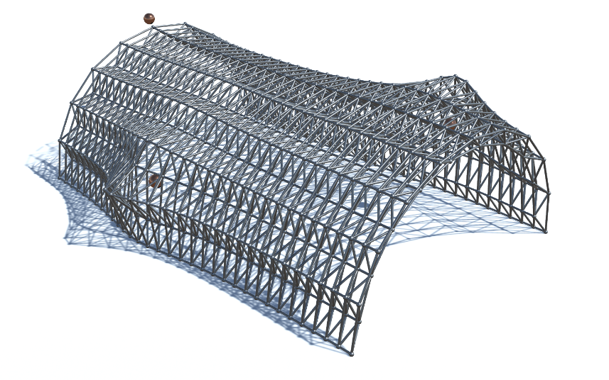
Evaluation
8 algorithms
3 runs per algorithm
15 iterations per run
15 individuals/particles per iteration
5400 candidate designs
Notes:
For a grand total of 5400 candidate designs evaluated in the end
(3x15x15x8)

Slide 56
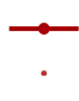
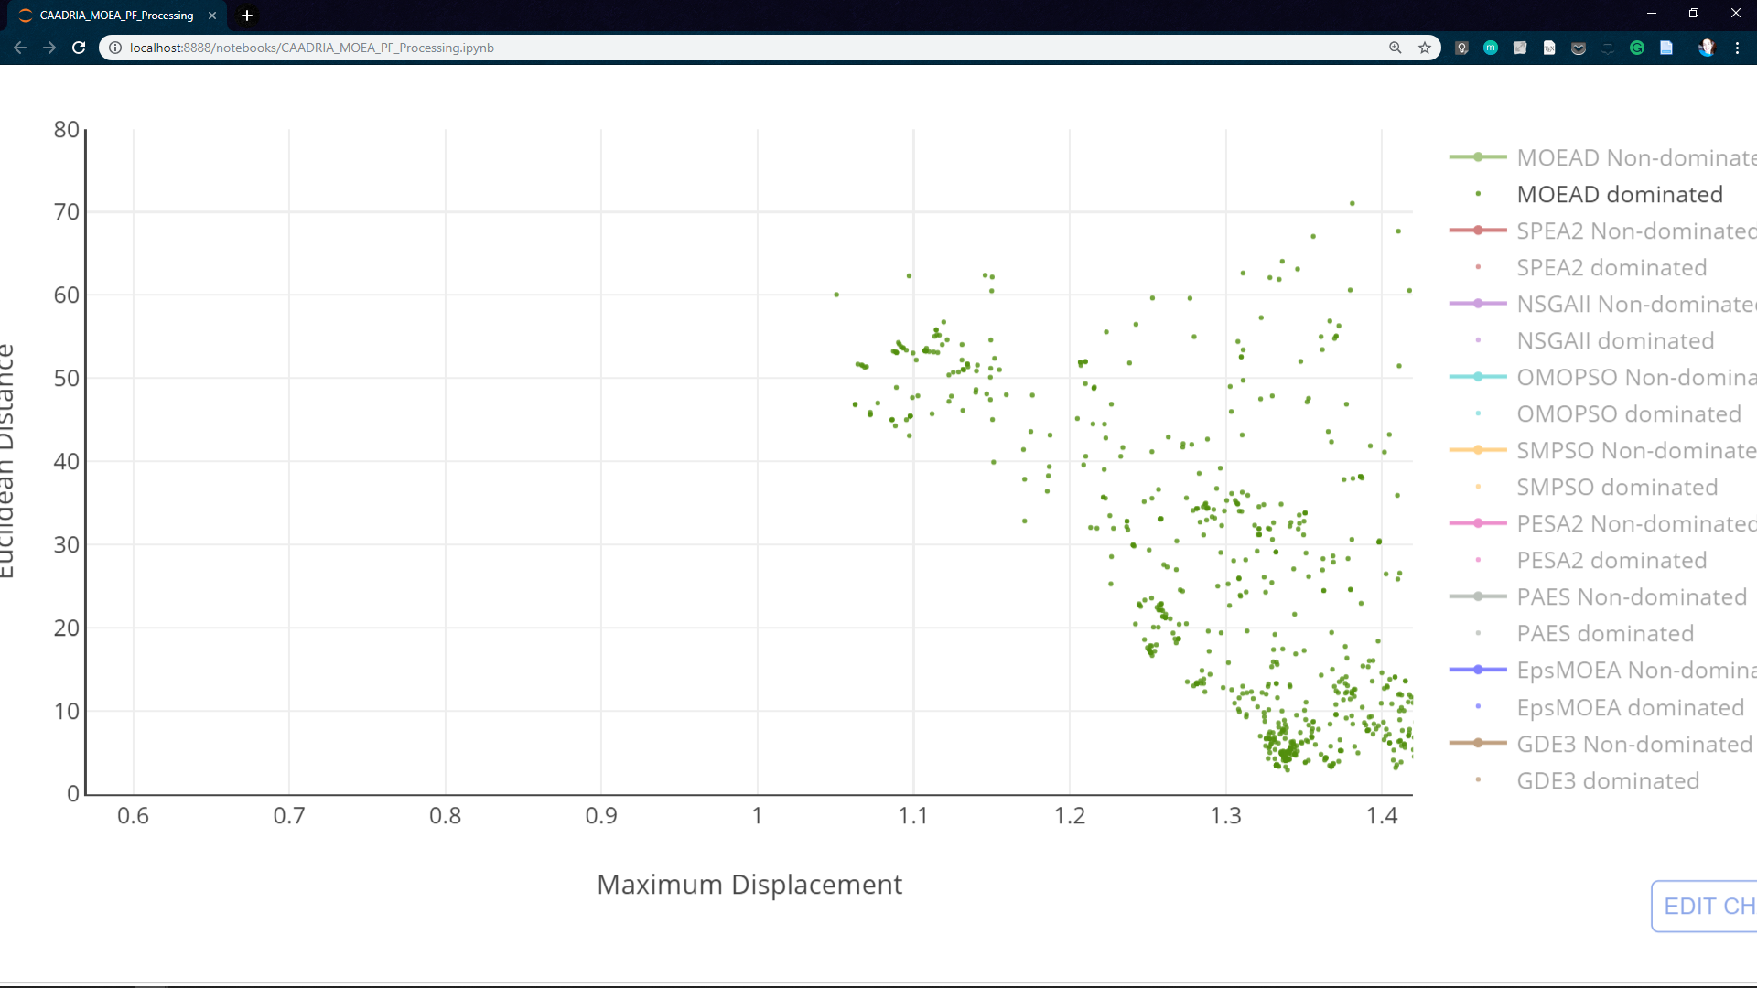
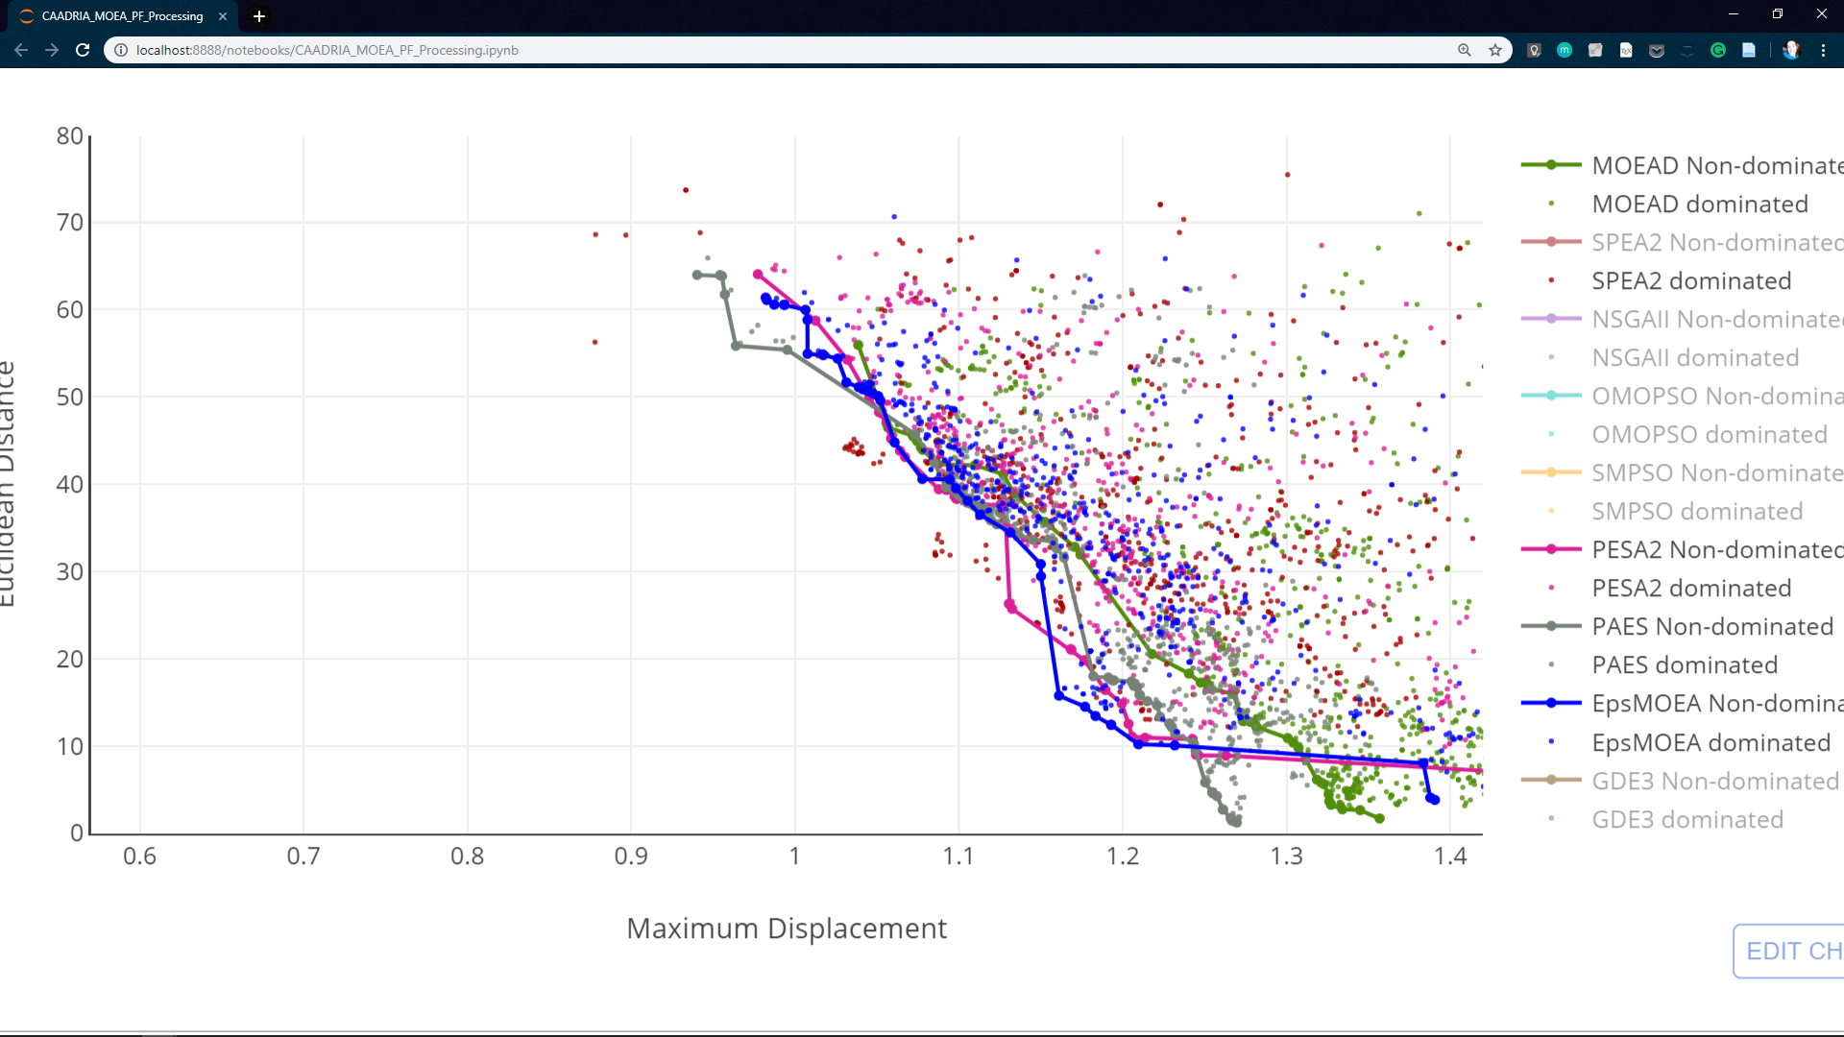
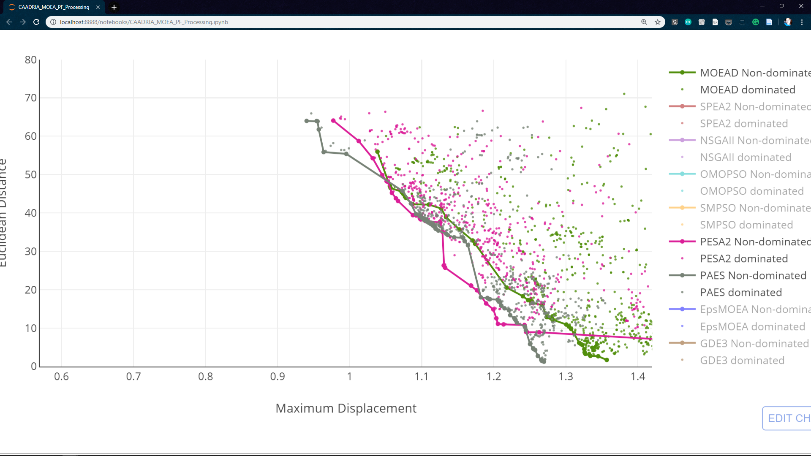
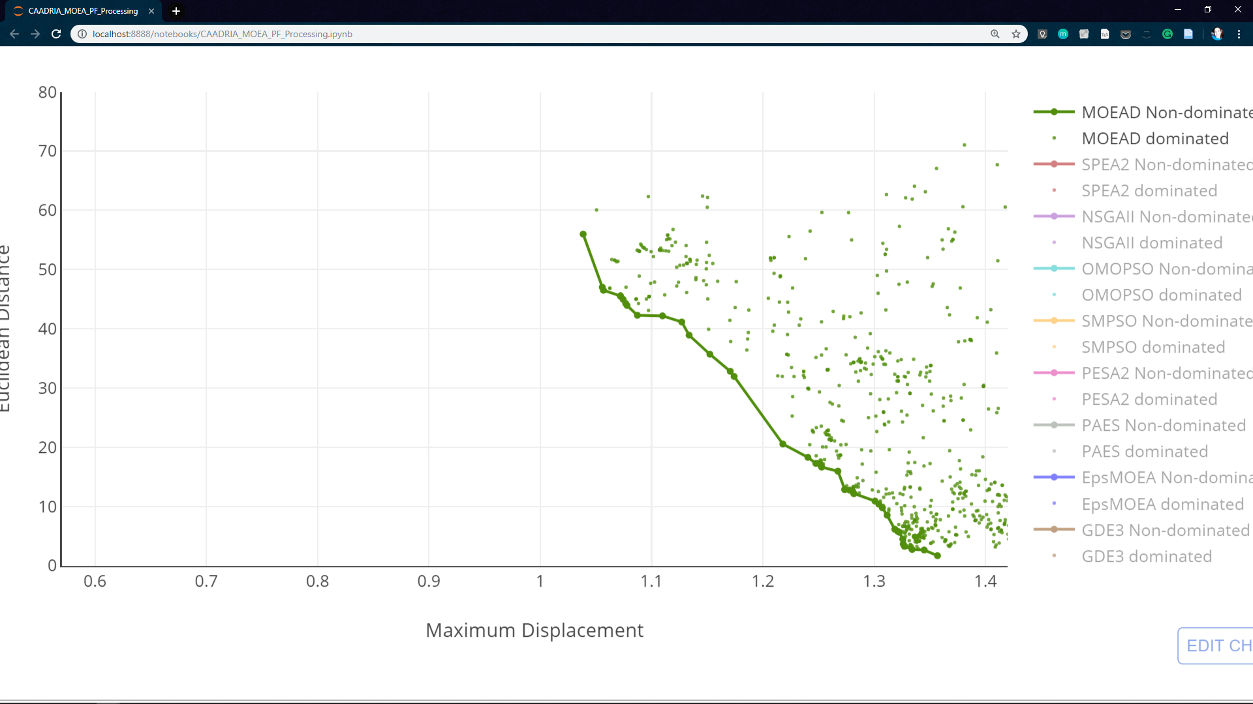
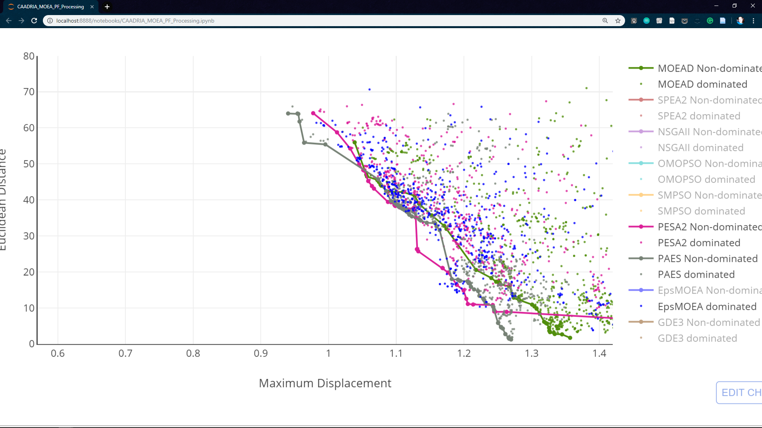
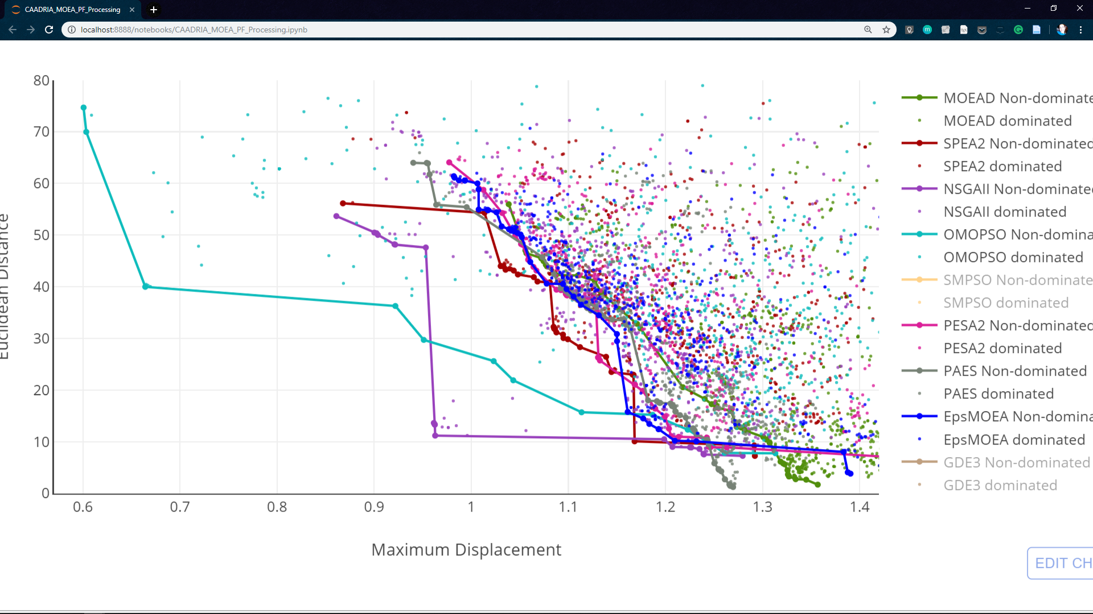
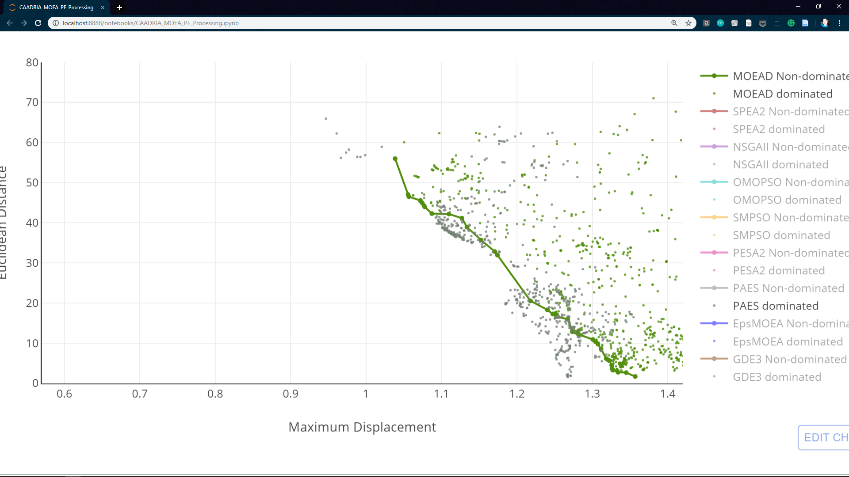
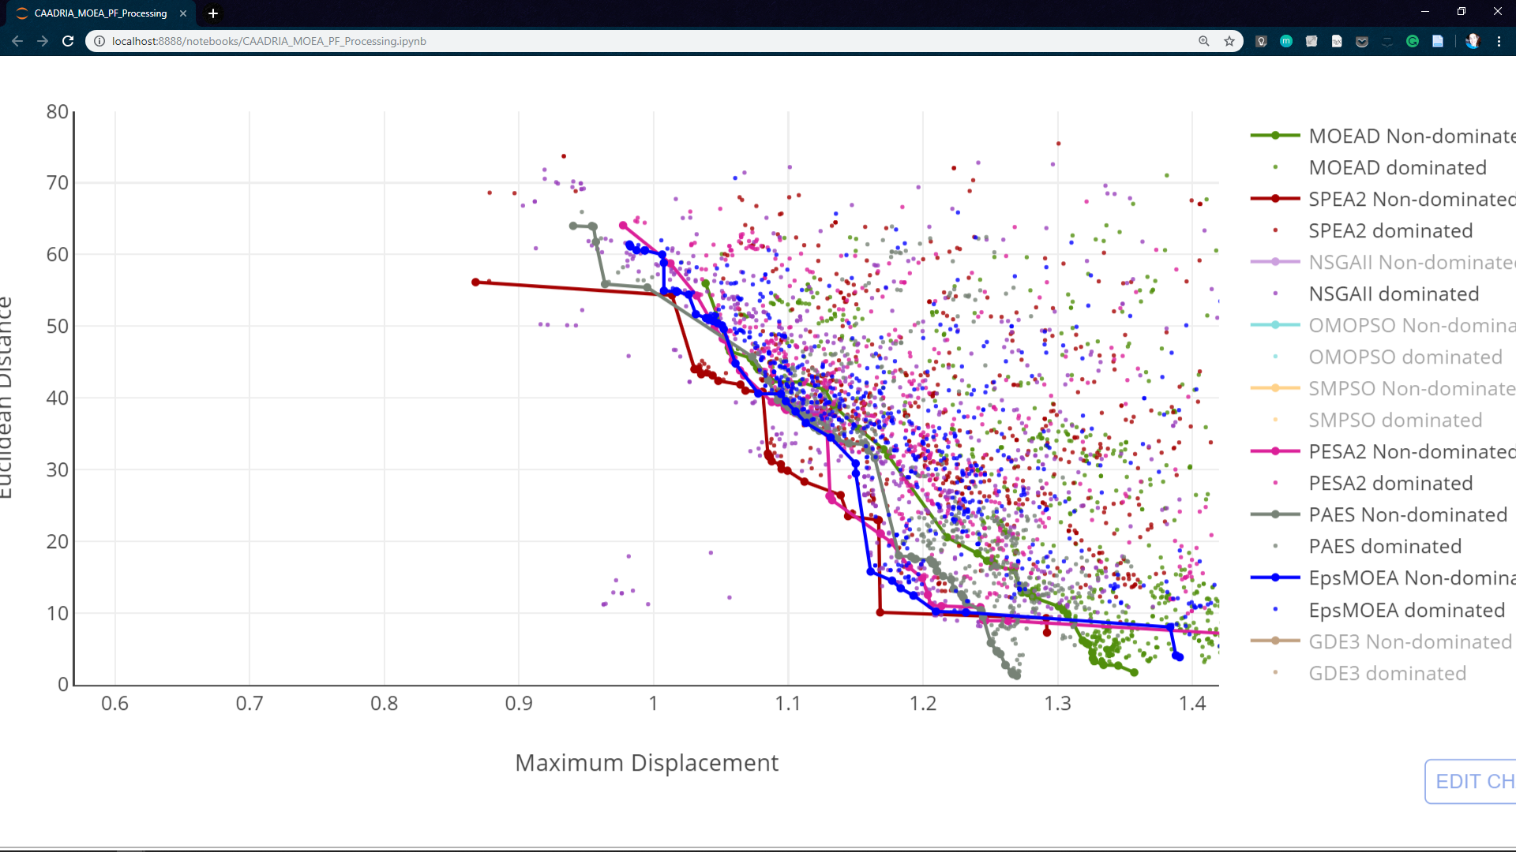
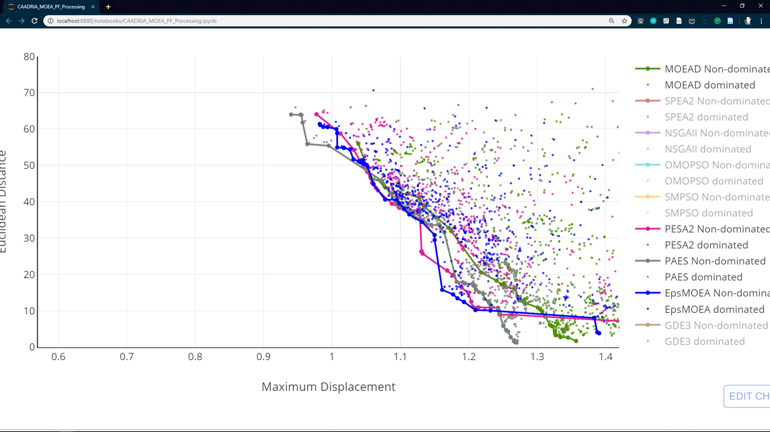
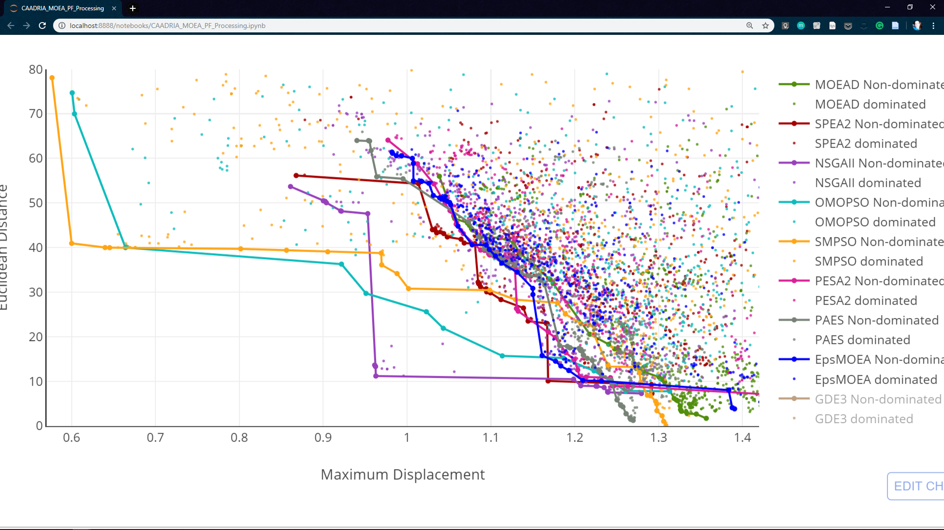
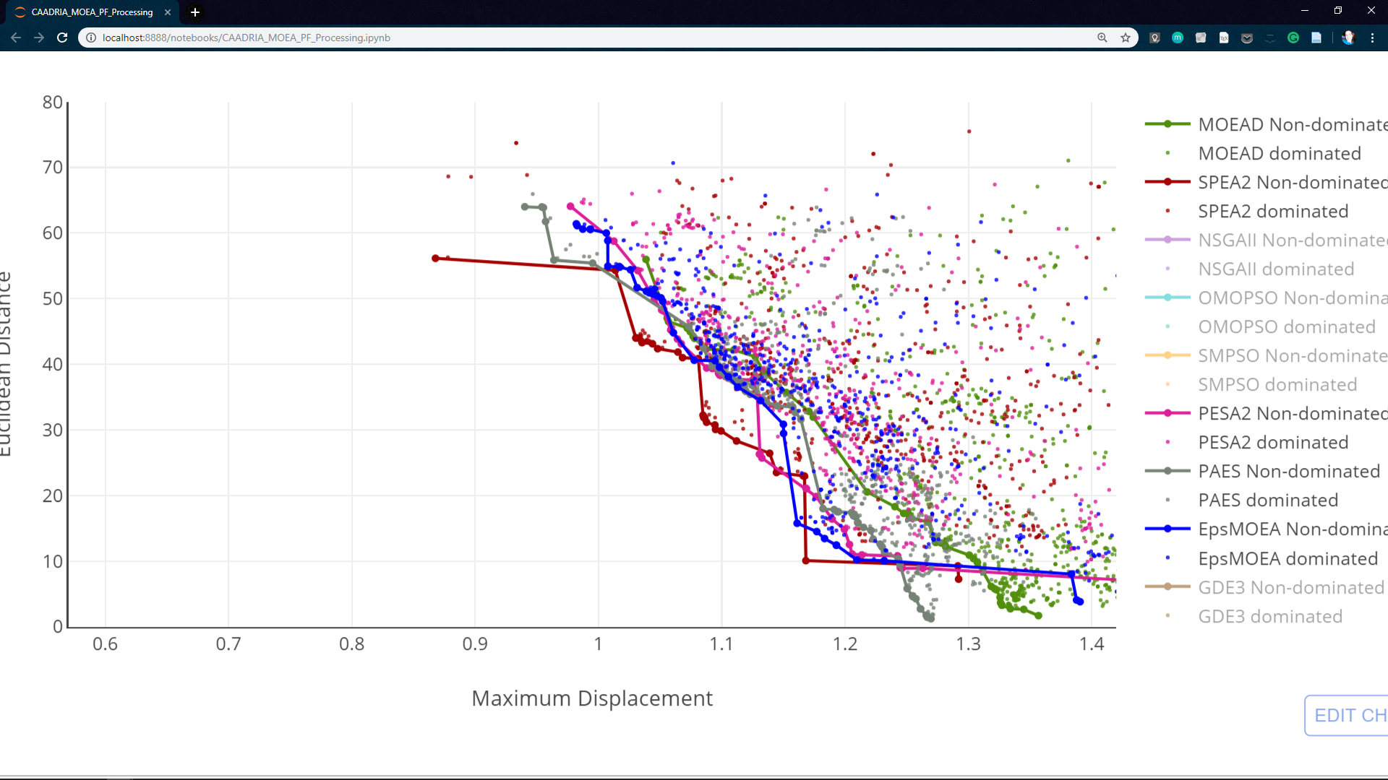
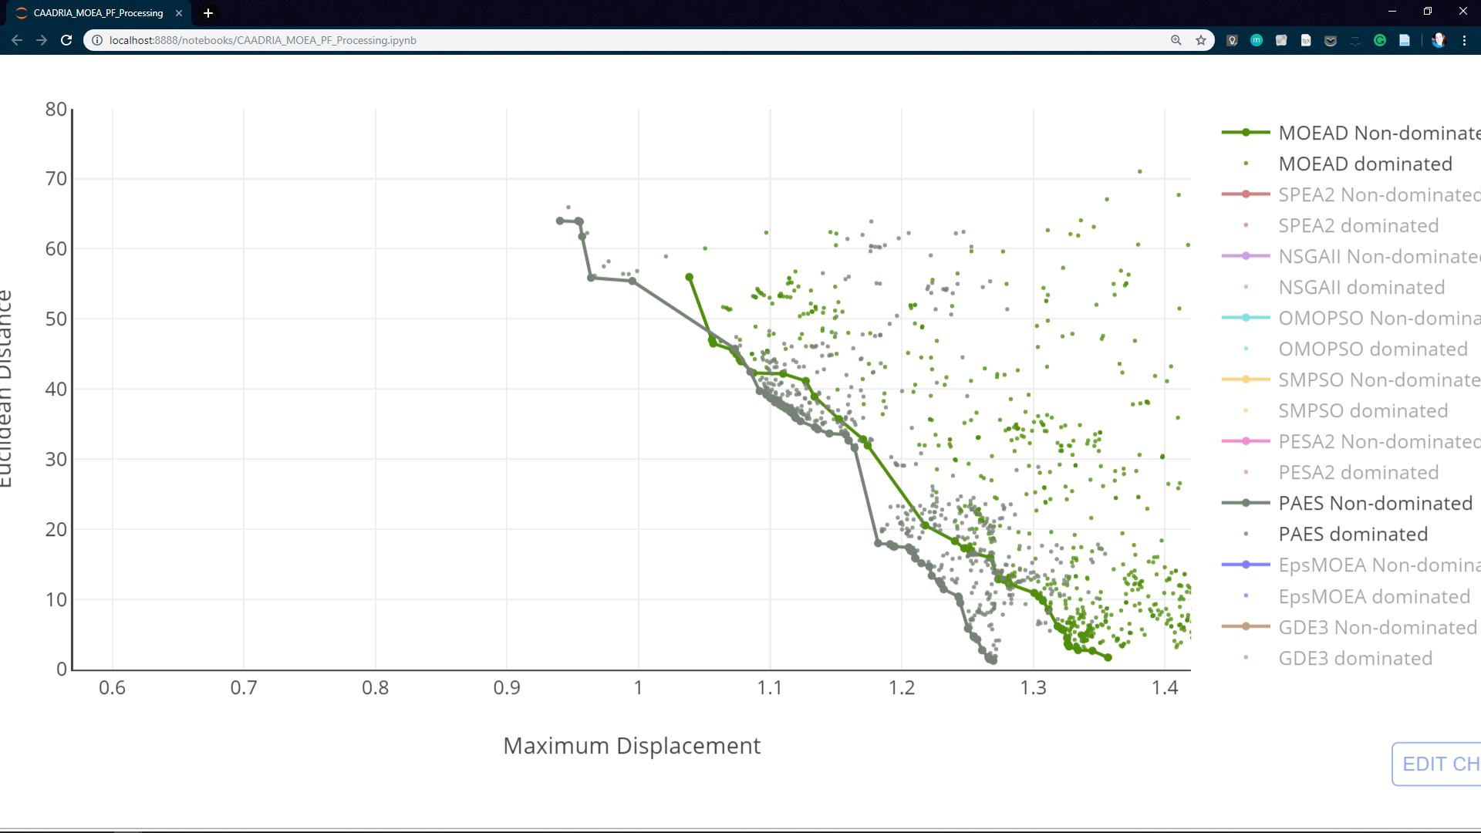

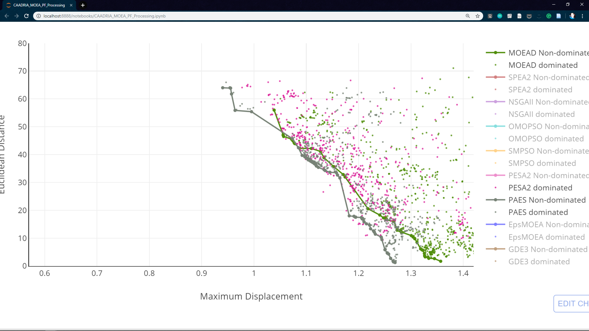
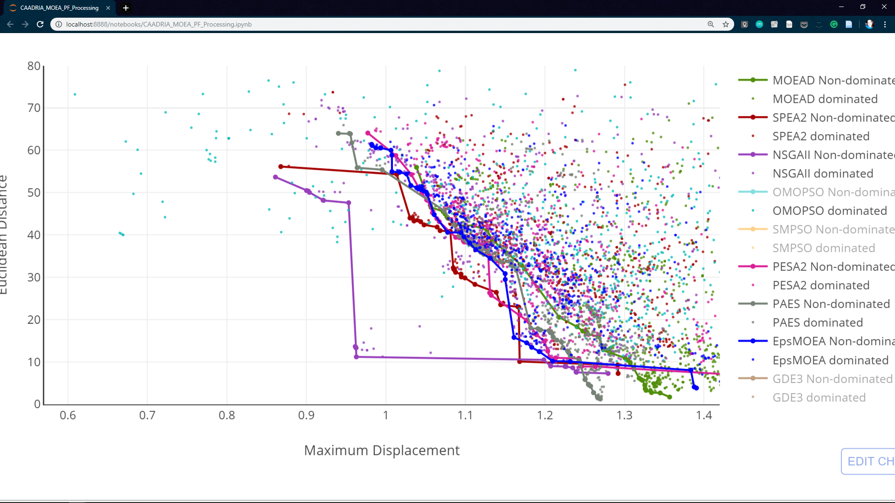
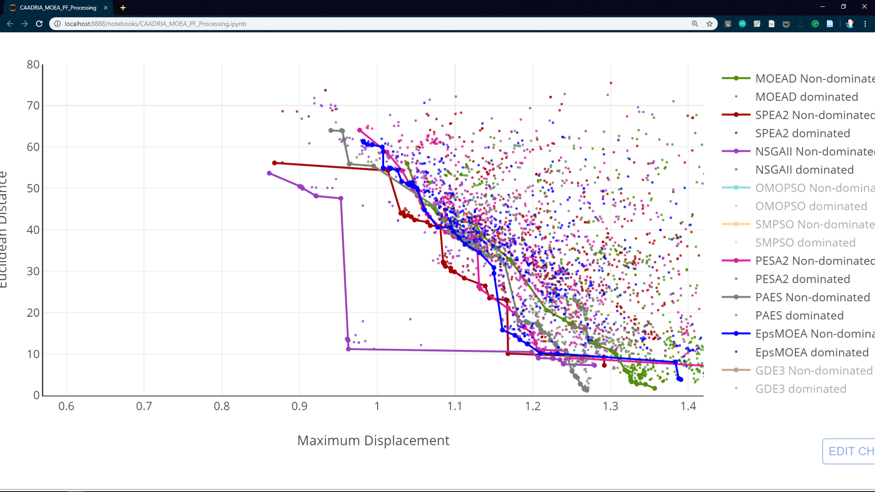
Pareto Front
Dominated solutions
Attractor Distance
Maximum Displacement
Notes:
(as I said before) we wanted to minimize both axis.
x-axis → maximum displacement
y-axis → distance between attractors
I’ll show you the results obtained by each algorithm:::

Slide 57
Pareto Front
Dominated solutions
MOEA/D
Attractor Distance
Maximum Displacement
Notes:
MOEA/D - Multi-Objective Evolutionary Algorithm with decomposition

Slide 58
Pareto Front
Dominated solutions
MOEA/D
Attractor Distance
Maximum Displacement
Notes:
MOEA/D - Multi-Objective Evolutionary Algorithm with decomposition
The pareto front

Slide 59
Pareto Front
Dominated solutions
MOEA/D
PAES
Attractor Distance
Maximum Displacement
Notes:
PAES - Pareto Archived Evolution Strategy

Slide 60
Pareto Front
Dominated solutions
MOEA/D
PAES
Attractor Distance
Maximum Displacement
Notes:
PAES - Pareto Archived Evolution Strategy
The pareto front

Slide 61
Pareto Front
Dominated solutions
MOEA/D
PAES
PESA2
Attractor Distance
Maximum Displacement
Notes:
PESA2 - Pareto Envelope-Based Selection Algorithm 2

Slide 62
Pareto Front
Dominated solutions
MOEA/D
PAES
PESA2
Attractor Distance
Maximum Displacement
Notes:
PESA2 - Pareto Envelope-Based Selection Algorithm 2
The pareto front

Slide 63
Pareto Front
Dominated solutions
MOEA/D
PAES
PESA2
ε-MOEA
Attractor Distance
Maximum Displacement
Notes:
EpsMOEA – Epsilon Multi-Objective Evolutionary Algorithm

Slide 64
Pareto Front
Dominated solutions
MOEA/D
PAES
PESA2
ε-MOEA
Attractor Distance
Maximum Displacement
Notes:
EpsMOEA – Epsilon Multi-Objective Evolutionary Algorithm
Pareto front

Slide 65
Pareto Front
Dominated solutions
MOEA/D
PAES
PESA2
ε-MOEA
SPEA2
Attractor Distance
Maximum Displacement
Notes:
SPEA2 - Strength Pareto Evolutionary Algorithm 2

Slide 66
Pareto Front
Dominated solutions
MOEA/D
PAES
PESA2
ε-MOEA
SPEA2
Attractor Distance
Maximum Displacement
Notes:
SPEA2 - Strength Pareto Evolutionary Algorithm 2
Pareto front

Slide 67
Pareto Front
Dominated solutions
MOEA/D
PAES
PESA2
ε-MOEA
SPEA2
Attractor Distance
NSGA-II
Maximum Displacement
Notes:
NSGAII - Non-dominated Sorting Genetic Algorithm II

Slide 68
Pareto Front
Dominated solutions
MOEA/D
PAES
PESA2
ε-MOEA
SPEA2
Attractor Distance
NSGA-II
Maximum Displacement
Notes:
NSGAII - Non-dominated Sorting Genetic Algorithm II
Pareto front

Slide 69
Pareto Front
Dominated solutions
MOEA/D
PAES
PESA2
ε-MOEA
SPEA2
Attractor Distance
NSGA-II
OMOPSO
SMPSO
Maximum Displacement
Notes:
OMOPSO –Multi-Objective Particle Swarm Optimization

Slide 70
Pareto Front
Dominated solutions
MOEA/D
PAES
PESA2
ε-MOEA
SPEA2
Attractor Distance
NSGA-II
OMOPSO
SMPSO
Maximum Displacement
Notes:
OMOPSO – OOOOO? Multi-Objective Particle Swarm Optimization
Pareto front

Slide 71
Pareto Front
Dominated solutions
MOEA/D
PAES
PESA2
ε-MOEA
SPEA2
Attractor Distance
NSGA-II
OMOPSO
SMPSO
Maximum Displacement
Notes:
SMPSO - Speed-constrained Multi-objective Particle Swarm Optimization

Slide 72
Pareto Front
Dominated solutions
MOEA/D
PAES
PESA2
ε-MOEA
SPEA2
Attractor Distance
NSGA-II
OMOPSO
SMPSO
Maximum Displacement
Notes:
SMPSO - Speed-constrained Multi-objective Particle Swarm Optimization
Pareto front

Slide 73
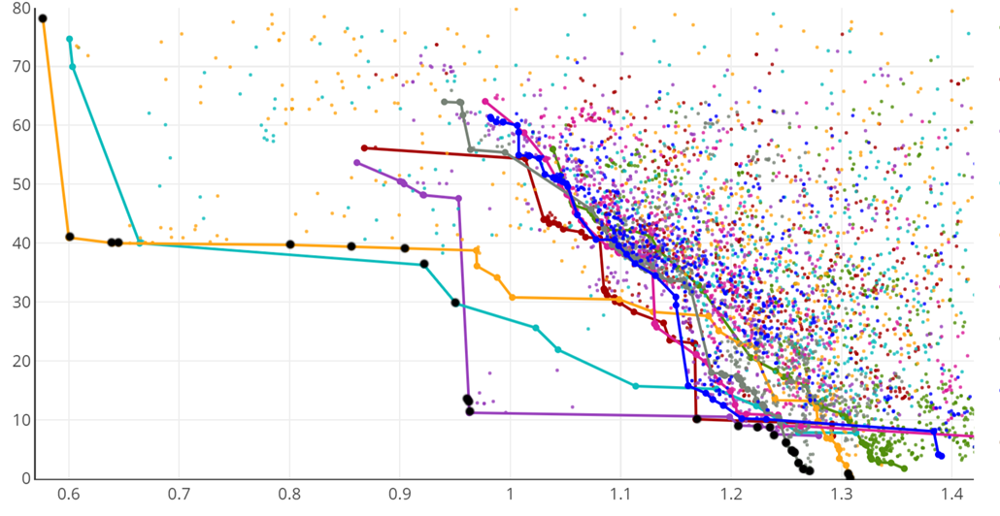
Pareto Front
Dominated solutions
MOEA/D
PAES
PESA2
ε-MOEA
SPEA2
Attractor Distance
NSGA-II
OMOPSO
SMPSO
Maximum Displacement
Notes:
Combined Pareto Front: The (33) black points represent the best solutions out of the 5400.
As you can see (on the bottom)…
Optimal solutions are seldomly isolated (due to the nature of the algorithms, which identify one good solution and then proceed to do small modifications to achieve solutions close to that one).
Epsilon-MOEA, MOEA/D and PESA2 didn’t find any optimal solutions.
All the others have at least one solution at the combined pareto front
- Most importanty: no algorithm is clearly better than the others

Slide 74
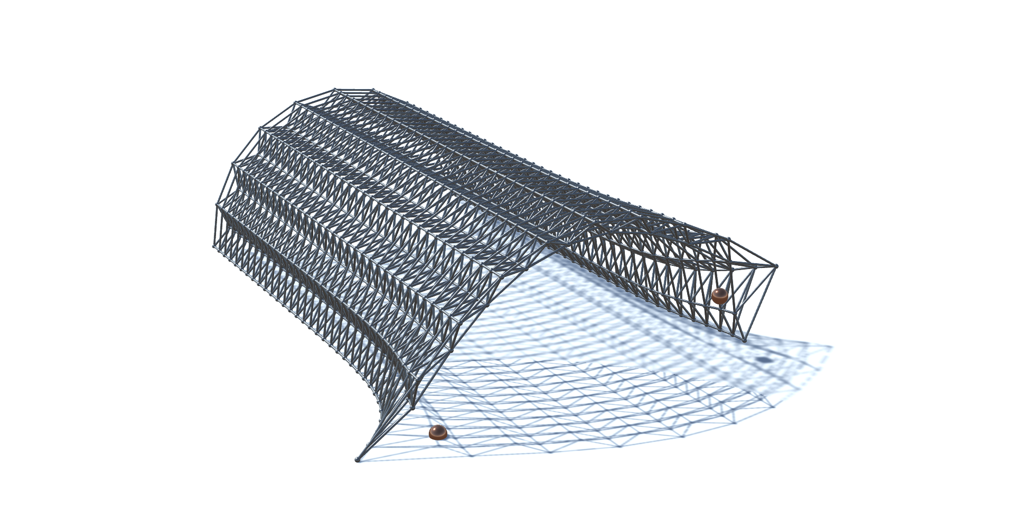
Attractor Distance
Maximum Displacement
Notes:
This is just to show you some of the obtained solutions at the pareto front
Beggining – here we have solutions found by the particle swarm algorithms only
middle – one from NSGA-II (purple)
End – a bunch of them from the evolutionay algorithms down there

Slide 75
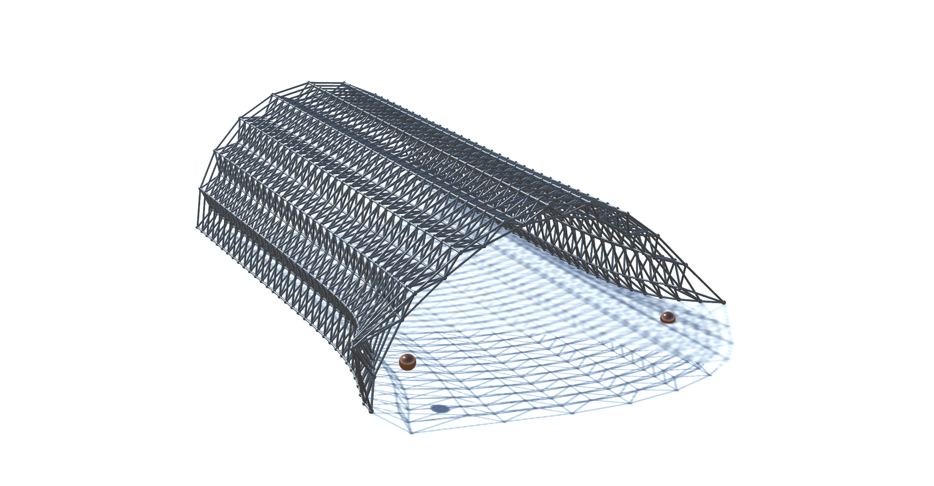
Attractor Distance
Maximum Displacement
Notes:
This is just to show you some of the obtained solutions at the pareto front
Beggining – here we have solutions found by the particle swarm algorithms only
middle – one from NSGA-II (purple)
End – a bunch of them from the evolutionay algorithms down there

Slide 76
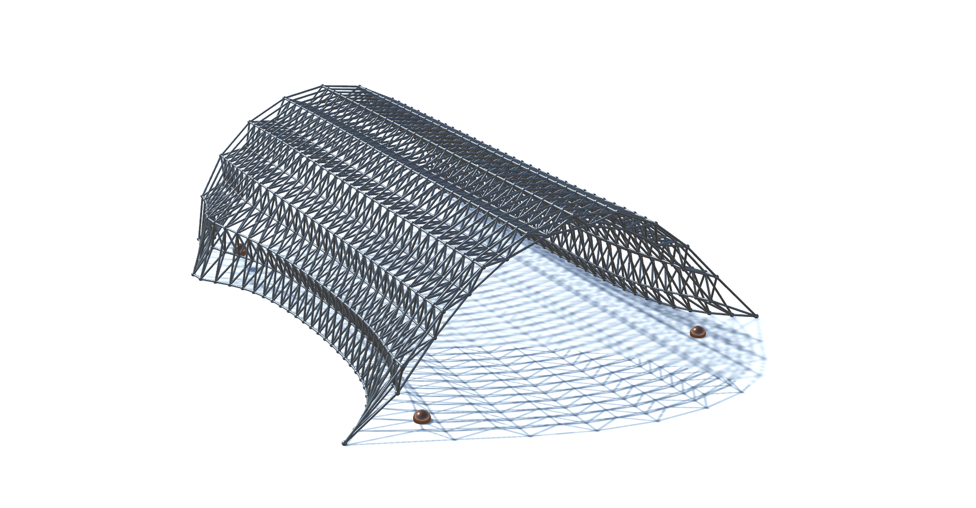
Attractor Distance
Maximum Displacement
Notes:
This is just to show you some of the obtained solutions at the pareto front
Beggining – here we have solutions found by the particle swarm algorithms only
middle – one from NSGA-II (purple)
End – a bunch of them from the evolutionay algorithms down there

Slide 77
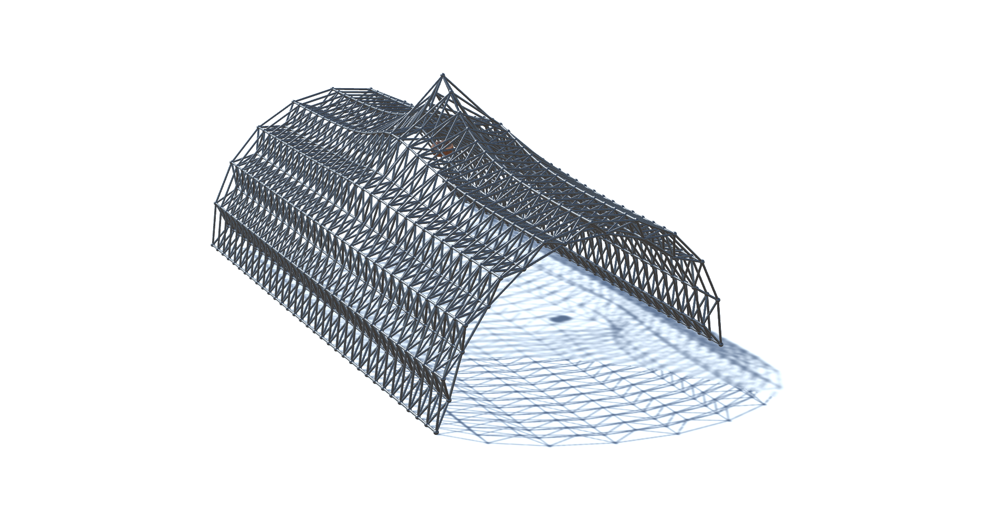
Attractor Distance
Maximum Displacement
Notes:
This is just to show you some of the obtained solutions at the pareto front
Beggining – here we have solutions found by the particle swarm algorithms only
middle – one from NSGA-II (purple)
End – a bunch of them from the evolutionay algorithms down there

Slide 78
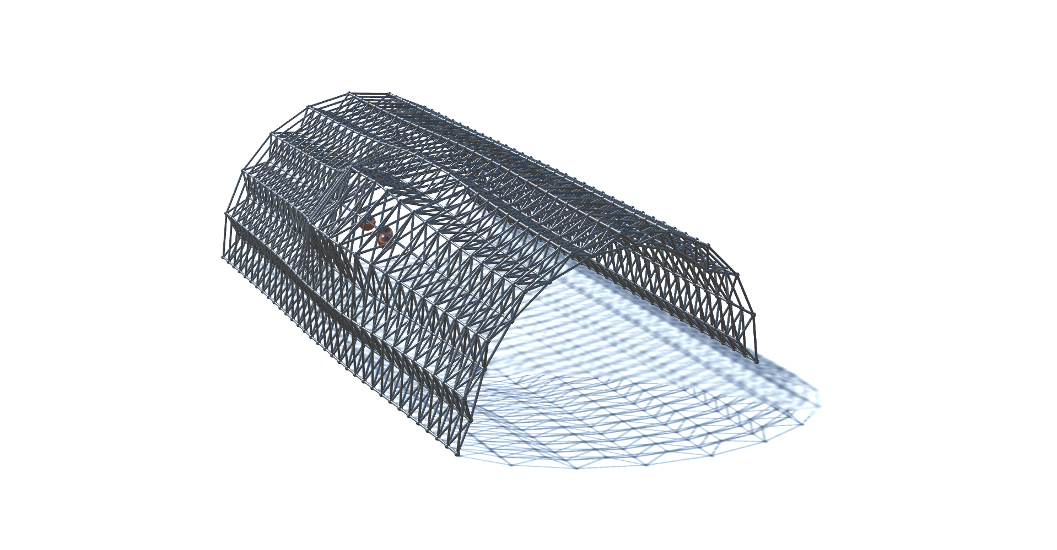
Attractor Distance
Maximum Displacement
Notes:
This is just to show you some of the obtained solutions at the pareto front
Beggining – here we have solutions found by the particle swarm algorithms only
middle – one from NSGA-II (purple)
End – a bunch of them from the evolutionay algorithms down there

Slide 79
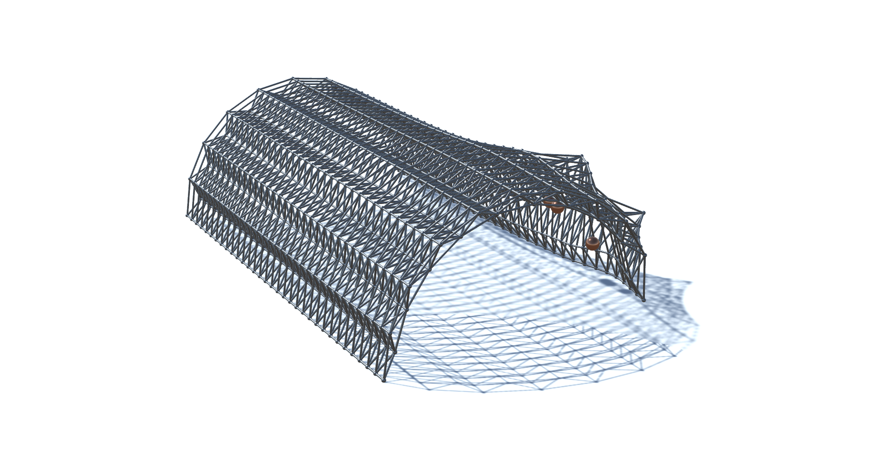
Attractor Distance
Maximum Displacement
Notes:
This is just to show you some of the obtained solutions at the pareto front
Beggining – here we have solutions found by the particle swarm algorithms only
middle – one from NSGA-II (purple)
End – a bunch of them from the evolutionay algorithms down there

Slide 80
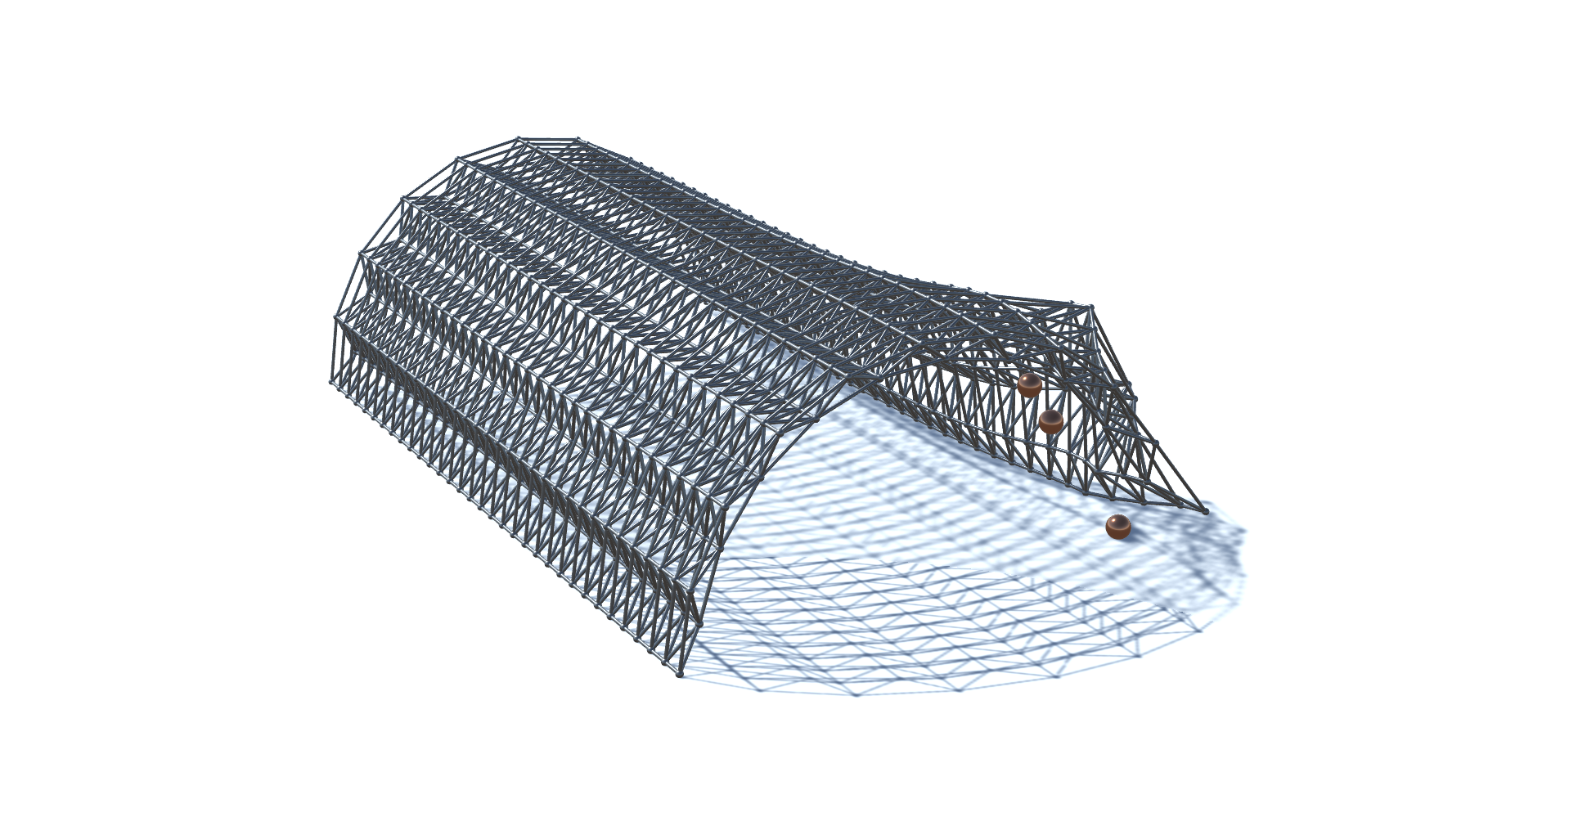
Attractor Distance
Maximum Displacement
Notes:
This is just to show you some of the obtained solutions at the pareto front
Beggining – here we have solutions found by the particle swarm algorithms only
middle – one from NSGA-II (purple)
End – a bunch of them from the evolutionay algorithms down there

Slide 81
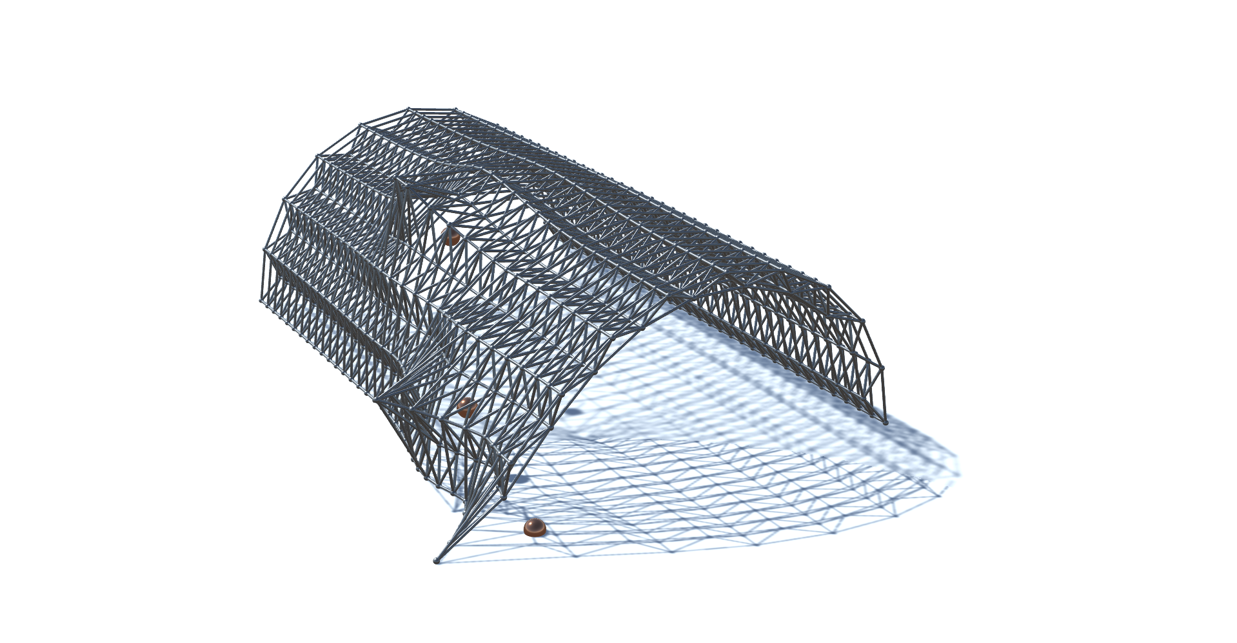
Attractor Distance
Maximum Displacement
Notes:
This is just to show you some of the obtained solutions at the pareto front
Beggining – here we have solutions found by the particle swarm algorithms only
middle – one from NSGA-II (purple)
End – a bunch of them from the evolutionay algorithms down there

Slide 82
Cardinality Diversity Accuracy/Convergence
MOEA/D
PAES
PESA2
ε-MOEA
SPEA2
NSGA-II
OMOPSO
SMPSO
Notes:
Regarding the quality of the results returned by the algorithms
we evaluate them in 3 metrics:
[Cardinality] - [Diversity] - [Accuracy/Convergence]

Slide 83
Cardinality Diversity Accuracy/Convergence
MOEA/D
PAES
PESA2
ε-MOEA
SPEA2
NSGA-II
OMOPSO
SMPSO
Notes:
[Cardinality] – *size of solution set measures by the (ONVG metric - overall nondominated vector generation)
*Epsilon-MOEA and PAES retrieved the most solutions (38, 30, respectively)
OMOPSO, SMPSO, and NSGA-II returned the least solutions (15, 23, 23 resp)

Slide 84
Cardinality Diversity Accuracy/Convergence
MOEA/D
29.67
38.00
29.33
30.33
22.66
23.33
15.00
22.67
PAES
PESA2
ε-MOEA
SPEA2
NSGA-II
OMOPSO
SMPSO
Notes:
[Cardinality] – *size of solution set measures by the (ONVG metric - overall nondominated vector generation)
*Epsilon-MOEA and PAES retrieved the most solutions (38, 30, respectively)
OMOPSO, SMPSO, and NSGA-II returned the least solutions (15, 23, 23 resp)

Slide 85
Cardinality Diversity Accuracy/Convergence
MOEA/D
29.67
38.00
29.33
30.33
22.66
23.33
15.00
22.67
PAES
PESA2
ε-MOEA
SPEA2
NSGA-II
OMOPSO
SMPSO
Notes:
[Cardinality] – *size of solution set measures by the (ONVG metric - overall nondominated vector generation)
*Epsilon-MOEA and PAES retrieved the most solutions (38, 30, respectively)
OMOPSO, SMPSO, and NSGA-II returned the least solutions (15, 23, 23 resp)
REMEMBER: these are the average values of 3 runs, the graph before only showed one of them

Slide 86
Cardinality Diversity Accuracy/Convergence
MOEA/D
29.67
38.00
29.33
30.33
22.66
23.33
15.00
22.67
PAES
PESA2
ε-MOEA
SPEA2
NSGA-II
OMOPSO
SMPSO
Notes:
[Diversity] - measures the distribution of the solutions (should be as uniform as possible across the solution space)
*Only SMPSO, OMOPSO, and NSGA-II explored different areas of the solutions space, all others concentrated in the same área (point to the dense region in graph)

Slide 87
Cardinality Diversity Accuracy/Convergence
22.66
29.67
23.33
15.00
22.67
29.33
38.00
30.33
NSGA-II
OMOPSO
SMPSO
Notes:
[Diversity] - measures the distribution of the solutions (should be as uniform as possible across the solution space)
*Only SMPSO, OMOPSO, and NSGA-II explored different areas of the solutions space, all others concentrated in the same área (point to the dense region in graph)

Slide 88
Cardinality Diversity Accuracy/Convergence
MOEA/D
29.67 | 53.39
38.00 | 29.15
29.33 | 49.78
30.33 | 44.61
22.66 | 44.16
23.33 | 47.86
15.00 | 54.72
22.67 | 69.21
PAES
PESA2
ε-MOEA
SPEA2
NSGA-II
OMOPSO
SMPSO
Notes:
[Diversity] – Here we have the values for maximum Spread
- *SMPSO, OMOPSO explored largest extent
- SPEA2 and PAES the least extense.

Slide 89
Cardinality Diversity Accuracy/Convergence
MOEA/D
29.67 | 53.39
38.00 | 29.15
29.33 | 49.78
30.33 | 44.61
22.66 | 44.16
23.33 | 47.86
15.00 | 54.72
22.67 | 69.21
PAES
PESA2
ε-MOEA
SPEA2
NSGA-II
OMOPSO
SMPSO
Notes:
[Diversity] – Here we have the values for maximum Spread
- *SMPSO, OMOPSO explored largest extent
- SPEA2 and PAES the least extense.

Slide 90
Cardinality Diversity Accuracy/Convergence
MOEA/D
29.67 | 53.39
38.00 | 29.15
29.33 | 49.78
30.33 | 44.61
22.66 | 44.16
23.33 | 47.86
15.00 | 54.72
22.67 | 69.21
PAES
PESA2
ε-MOEA
SPEA2
NSGA-II
OMOPSO
SMPSO
Notes:
[Accuracy/Convergence] - *how close the algorithms got to the Pareto Front = convergence to the black points
- we can see no algorithm lies perfectly on all these points, but SMPSO, MOEAD, and OMOPSO seem to converge

Slide 91
Cardinality Diversity Accuracy/Convergence
MOEA/D
OMOPSO
SMPSO
Notes:
[Accuracy/Convergence] - *how close the algorithms got to the Pareto Front = convergence to the black points
- we can see no algorithm lies perfectly on all these points, but SMPSO, MOEAD, and OMOPSO seem to converge

Slide 92
Cardinality Diversity Accuracy/Convergence
MOEA/D
29.67 | 53.39 | 0.72
38.00 | 29.15 | 2.26
29.33 | 49.78 | 1.08
30.33 | 44.61 | 1.23
22.66 | 44.16 | 1.08
23.33 | 47.86 | 1.04
15.00 | 54.72 | 0.86
22.67 | 69.21 | 0.54
PAES
PESA2
ε-MOEA
SPEA2
NSGA-II
OMOPSO
SMPSO
Notes:
[Accuracy/Convergence] - *how close the algorithms got to the Pareto Front = convergence to the black points
- we can see no algorithm lies perfectly on all these points, but SMPSO, MOEAD, and OMOPSO seem to converge
*as the values for IGD (Inverse Generational Distance) show

Slide 93
Cardinality Diversity Accuracy/Convergence
MOEA/D
29.67 | 53.39 | 0.72
38.00 | 29.15 | 2.26
29.33 | 49.78 | 1.08
30.33 | 44.61 | 1.23
22.66 | 44.16 | 1.08
23.33 | 47.86 | 1.04
15.00 | 54.72 | 0.86
22.67 | 69.21 | 0.54
PAES
PESA2
ε-MOEA
SPEA2
NSGA-II
OMOPSO
SMPSO
Notes:
[Accuracy/Convergence] - *how close the algorithms got to the Pareto Front = convergence to the black points
- we can see no algorithm lies perfectly on all these points, but SMPSO, MOEAD, and OMOPSO seem to converge
*as the values for IGD (Inverse Generational Distance) show

Slide 94
Cardinality Diversity Accuracy/Convergence
MOEA/D
29.67 | 53.39 | 0.72
38.00 | 29.15 | 2.26
29.33 | 49.78 | 1.08
30.33 | 44.61 | 1.23
22.66 | 44.16 | 1.08
23.33 | 47.86 | 1.04
15.00 | 54.72 | 0.86
22.67 | 69.21 | 0.54
PAES
PESA2
ε-MOEA
SPEA2
NSGA-II
OMOPSO
SMPSO
Notes:
These were the results, but of course we found it odd to have such a distribution gap
*in between the high-density region and the approximated Pareto Fronts.
We thought this could be the result of
insufficient iterations
insufficient population size
even intrinsic behaviors and heuristics used in evolutionary algorithms
So we tested some more algorithms

Slide 95
Pareto Front
Dominated solutions
MOEA/D
PAES
PESA2
ε-MOEA
SPEA2
Attractor Distance
NSGA-II
OMOPSO
SMPSO
Maximum Displacement
Notes:
These were the results, but of course we found it odd to have such a distribution gap
*in between the high-density region and the approximated Pareto Fronts.
We thought this could be the result of
insufficient iterations
insufficient population size
even intrinsic behaviors and heuristics used in evolutionary algorithms
So we tested some more algorithms (after submitting the paper)

Slide 96
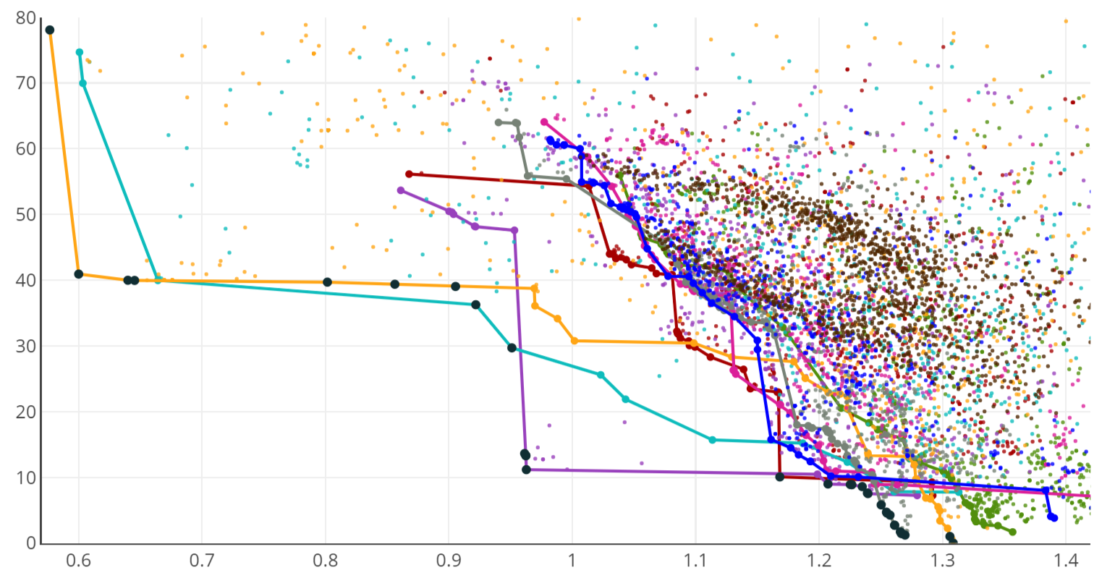
Pareto Front
Dominated solutions
MOEA/D
PAES
PESA2
ε-MOEA
SPEA2
Attractor Distance
NSGA-II
OMOPSO
SMPSO
CMA-ES
GDE3
Maximum Displacement
Notes:
CMA-ES - Covariance Matrix Adaptation Evolution Strategy

Slide 97
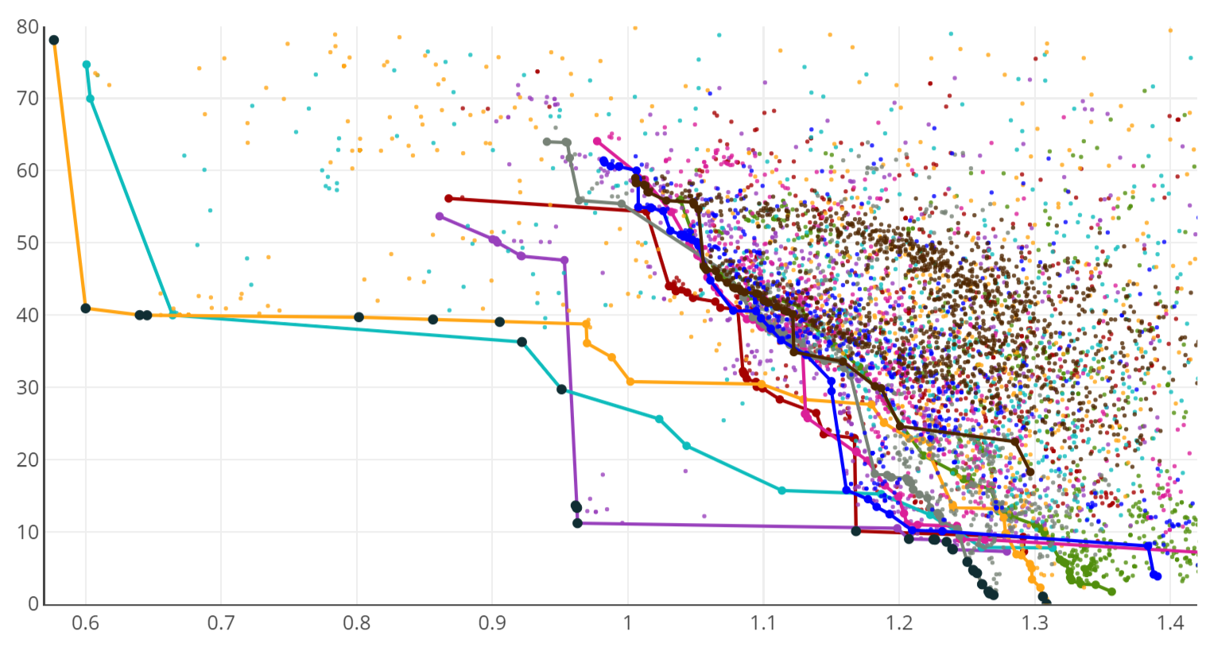
Pareto Front
Dominated solutions
MOEA/D
PAES
PESA2
ε-MOEA
SPEA2
Attractor Distance
NSGA-II
OMOPSO
SMPSO
CMA-ES
GDE3
Maximum Displacement
Notes:
CMA-ES - Covariance Matrix Adaptation Evolution Strategy
To no avail

Slide 98
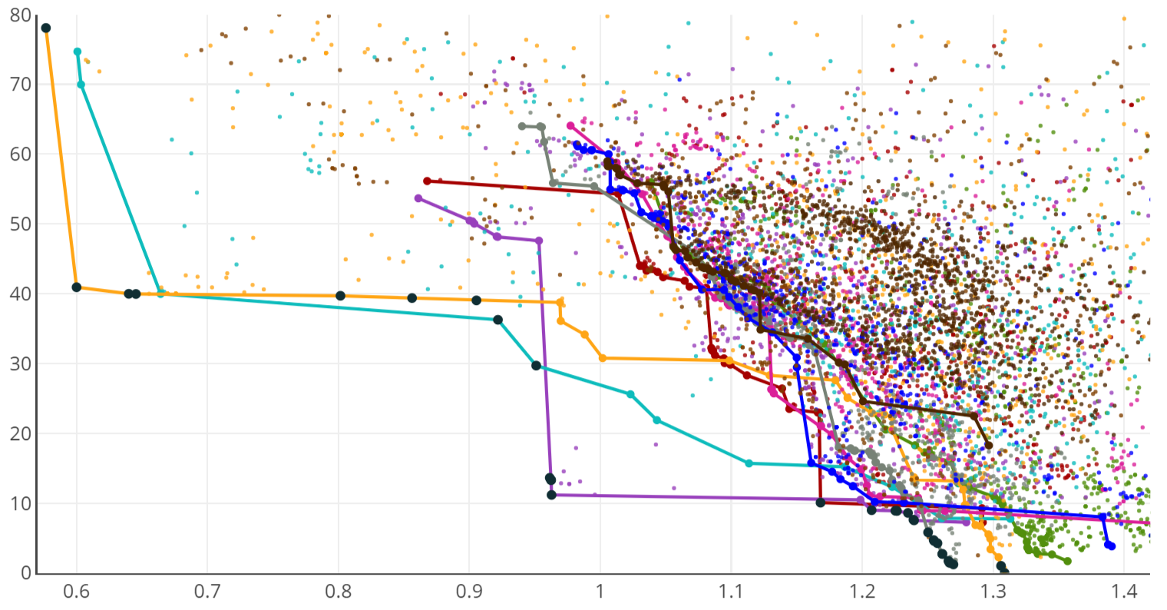
Pareto Front
Dominated solutions
MOEA/D
PAES
PESA2
ε-MOEA
SPEA2
Attractor Distance
NSGA-II
OMOPSO
SMPSO
CMA-ES
GDE3
Maximum Displacement
Notes:
GDE3 – 3rd generation of Generalized Differential Evolution

Slide 99
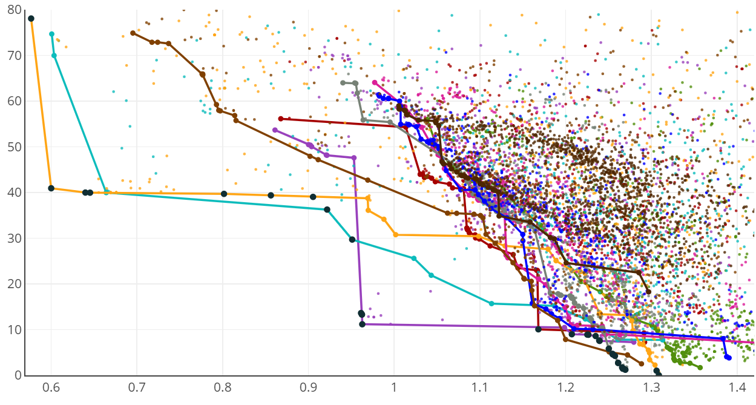
Pareto Front
Dominated solutions
MOEA/D
PAES
PESA2
ε-MOEA
SPEA2
Attractor Distance
NSGA-II
OMOPSO
SMPSO
CMA-ES
GDE3
Maximum Displacement
Notes:
GDE3 – 3rd generation of Generalized Differential Evolution
Crossed the gap, but there is still a substatial part of the gap to cover
So we ran multiple algorithms for a long time, and we obtained this graph...
Just goes to prove the need to test multiple algorithms.

Slide 100

Results
0.9218245085248372
1.3087223923156133
0.0
36.2662398087506
Notes:
To sum up this evaluation I’m just showing you three Pareto-optimal solutions that reflect different compromises among the two objectives.
*structural efficiency & *distance between attractors
Left = best solution for the space-frame in terms of attractor distance, they are coincident. This creates an enormous deformity in the middle of the truss and it has a poorer structural performance
Middle = variation of the first, but where the attractors are not all concentric, but are still located near each other.
Right = one solution that spreads the attractors even more to better structural efficiency (less displacement).
Note that, we have no access to the true optimal solutions and, therefore, there might be better solutions that have not been found by the algorithms.

Slide 101
Results
Structural Efficiency increase
0.9218245085248372
1.3087223923156133
0.0
36.2662398087506
Notes:
To sum up this evaluation I’m just showing you three Pareto-optimal solutions that reflect different compromises among the two objectives.
*structural efficiency & *distance between attractors
Left = best solution for the space-frame in terms of attractor distance, they are coincident. This creates an enormous deformity in the middle of the truss and it has a poorer structural performance
Middle = variation of the first, but where the attractors are not all concentric, but are still located near each other.
Right = one solution that spreads the attractors even more to better structural efficiency (less displacement).
Note that, we have no access to the true optimal solutions and, therefore, there might be better solutions that have not been found by the algorithms.

Slide 102
Results
Structural Efficiency increase
0.9218245085248372
1.3087223923156133
0.0
36.2662398087506
Attractor Distance decrease
Notes:
To sum up this evaluation I’m just showing you three Pareto-optimal solutions that reflect different compromises among the two objectives.
*structural efficiency & *distance between attractors
Left = best solution for the space-frame in terms of attractor distance, they are coincident. This creates an enormous deformity in the middle of the truss and it has a poorer structural performance
Middle = variation of the first, but where the attractors are not all concentric, but are still located near each other.
Right = one solution that spreads the attractors even more to better structural efficiency (less displacement).
Note that, we have no access to the true optimal solutions and, therefore, there might be better solutions that have not been found by the algorithms.

Slide 103
Conclusions
Notes:
This was a comparative study on Pareto-based approaches to Multi objective optimization problems

Slide 104
Conclusions
Higher level of information
Quality of results [accuracy, diversity, and cardinality]
Importance of visualization mechanisms
Notes:
This was a comparative study on Pareto-based approaches to Multi objective optimization problems
Pareto Optimization is more informative that its optimization counterparts
Literature review showed no apparent consensus regarding the best way to assess the quality of Pareto approaches. We decided to apply different metrics simultaneously
We went with a combination of Multi objective optimization performance metrics and Pareto Front plots. And indeed Pareto optimization greatly benefits from graphical plots.

Slide 105
Conclusions
Higher level of information
Quality of results [accuracy, diversity, and cardinality]
Importance of visualization mechanisms
Slow
Do not use EAs blindly. Test other algorithms as well
Notes:
Problems:
These approaches are slow, as they must explore the objective space to a large extent.
Surrogate models might help reducing this time.
Tests are relevant for algorithm selection - Evolutionary algorithms are not always the answer to all the problems. SPEA2, currently known as one of the best evolutionary algorithms, exhibited poor performance in this case.
(Particle swarm algorithms cover a large extent of the objective space, but evolutionary algorithms tend to spend lots of time evaluating the same region (e.g. NSGA-II))

Slide 106
Future Work
Compare with other approaches
More complex case studies
More and diverse objectives
Visualization mechanisms
Surrogate models
Notes:
As future work:
we want to compare this to other approaches
consider the application of these algorithms to more complex designs
And with more diverse objectives = higher number of variables
In problems with a larger number of objectives → difficult to visualize the trade-offs between objectives. Thus, we plan to study visualization mechanisms tailored for higher-dimensional problems
Combine surrogate models with multi-objective evolutionary algorithms to speed things up

Slide 107
Thank you!
Catarina Belém
catarina.belem@tecnico.ulisboa.pt
António Menezes Leitão
antonio.menezes.leitao@tecnico.ulisboa.pt

